Slide 1


Category- and Data-driven Meta-analyses
Comparison of Different Approaches for Identification of Consistent Aberrant Brain Activation in Psychiatric Disorders
Sept.10 2026 I Changyi Kuang, CAB group, INM-7, Forschungszentrum Jülich
Notes:
Hi everyone, thank you for being here.
Today, I’ll present our project, “Category- and Data-driven Meta-analysis of Aberrant Brain Activation in Psychiatric Disorders.”
This project uses ALE to investigate altered brain activation across multiple diagnoses.
放松😌 放慢速度就可以了 时间肯定来得及

Slide 2
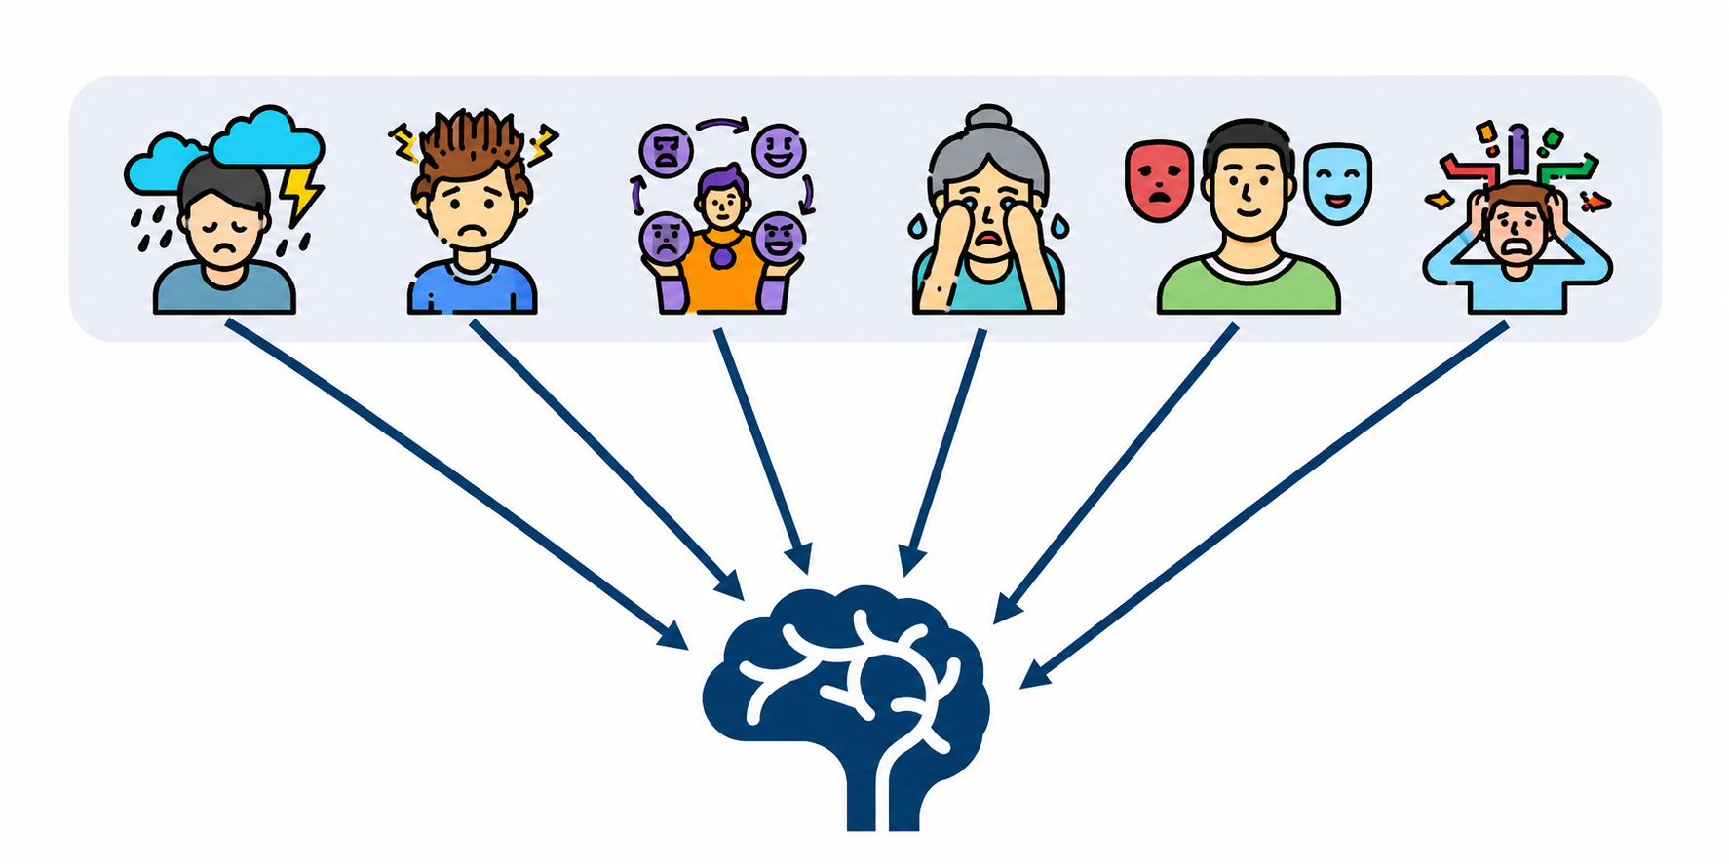
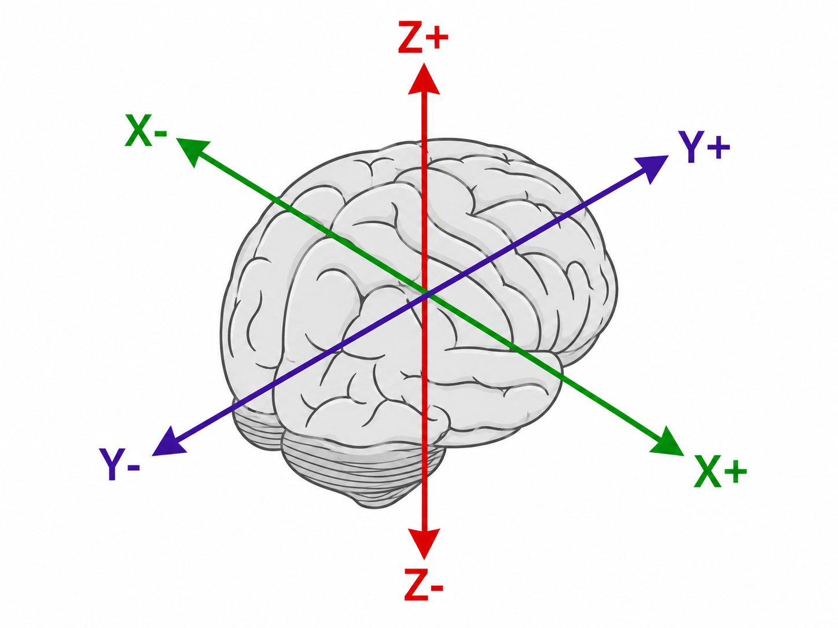
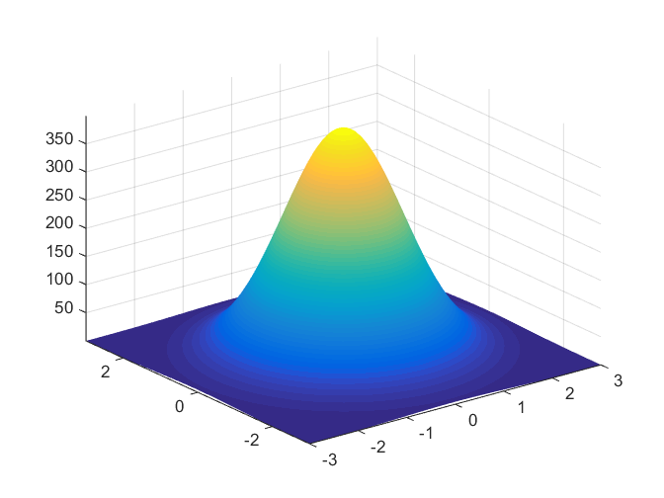
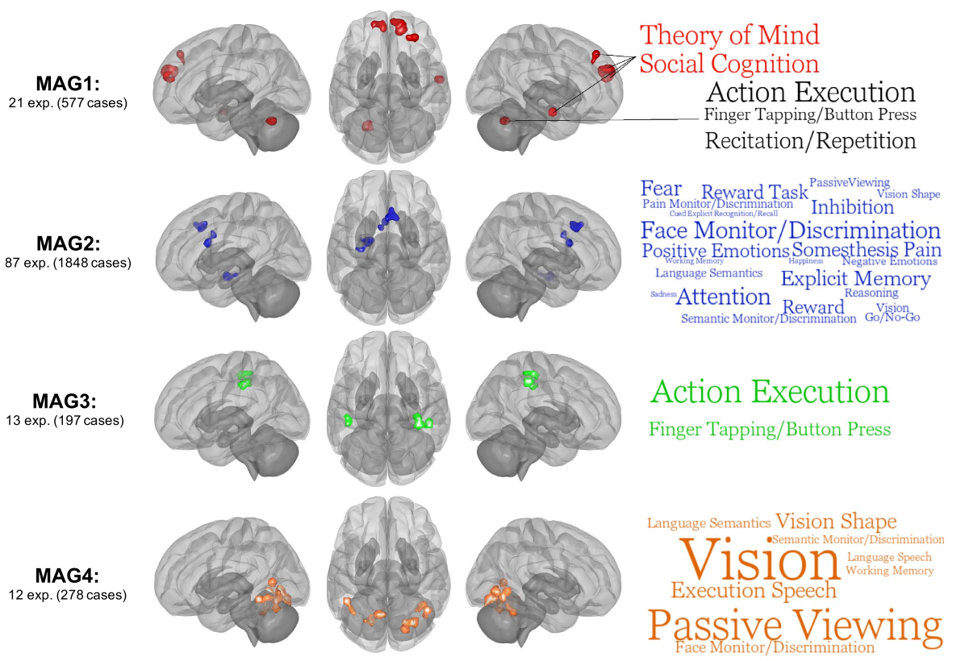
Introduction
Clinical Motivation and Current Solution
Emotional Dysfunction
Common symptom across psychiatric patients
Similar patterns across subtypes within the same disorder
Shared neural activity beyond diagnostic boundaries
Transdiagnostic Neuroimaging Meta-analyses
Identify convergent effect of diseases
Activation Likelihood Estimation (ALE)
Notes:
Emotional dysfunction is common across psychiatric disorders, and similar emotional symptoms can also appear across different subtypes of the same disorder.
This raises an interesting question: do these disorders share common alterations in the brain?
One way to address this is by doing transdiagnostic neuroimaging meta-analysis. And one of the most commonly used approaches is Activation Likelihood Estimation, or ALE.
By combining coordinate-based findings across many studies and diagnoses, ALE can identify brain regions showing relatively robust and reproducible convergence.
But What does this transdiagnostic convergence actually represent?

Slide 3






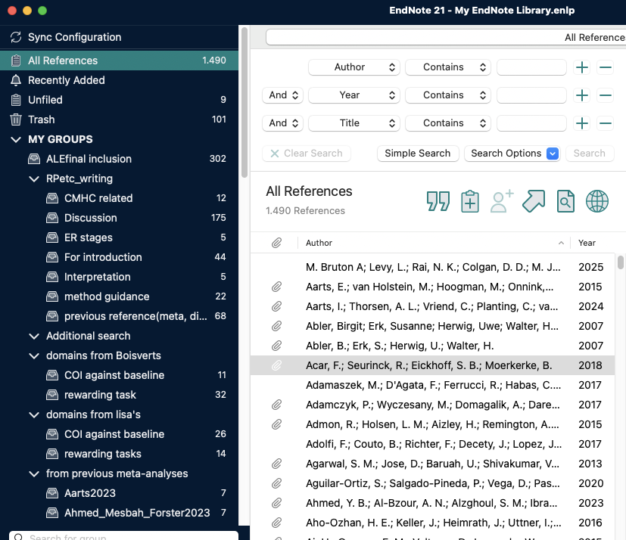
Introduction
Convergent Neural Alterations - and Beyond
Multiple diagnoses
Pool evidence
Convergent Neural Alteration
➤➤
？
A. Shared by Whom?
Is the effect genuinely shared across disorders?
B. What Is Covered?
Are disorder-specific effects missed by pooling?
C. Beyond Categories?
Are there latent patterns beyond diagnostic labels?
Notes:
A significant transdiagnostic ALE effect tells us where studies converge.
But it does not necessarily tell us the full story behind that convergence.
There are still three important questions.
First, is the effect really shared across disorders?
Second, could some diagnosis-specific effects be hidden after putting everything together?
And third, could predefined diagnostic categories cause us to miss other cross-diagnostic patterns?
So, we want to understand not only what is shared, but also what may be hidden or missed.

Slide 4

Introduction
Complementary Views of Cross-Diagnostic Neural Alterations
Same Coordinates
Category-Driven
Data-Driven
Predefined Grouping
Pattern-based Grouping
ALE Meta-Analyses across/within
existing groups
ALE Meta-analyses in
data-derived groups
Diagnosis-defined structure
Latent neural structure
Interpretation based on
theoretical taxonomy
Interpretation beyond predefined labels
Notes:
To address these questions, we used two complementary approaches.
In the category-driven approach, studies are first grouped according to diagnosis, and ALE is then performed within or across these diagnostic groups.
In the data-driven approach, we do not use diagnosis to define the groups. Instead, studies are grouped according to the spatial similarity of their reported brain coordinates.
So, the evidence is the same.
What changes is the way we organize that evidence.
This allows us to test whether a different grouping strategy can reveal additional cross-diagnostic patterns and provide a more comprehensive view of altered brain function across psychiatric disorders.

Slide 5
introduction
Research Questions
Transdiagnostic effects：
What is shared across diagnoses?
Diagnosis-specific effects：
What remains diagnosis-specific?
Data-driven cross-diagnostic effects：
What additional cross-diagnostic pattern may emerge?
An Overall cross-diagnostic ALE meta-analysis
Category-driven
Diagnosis-specific ALE meta-analyses
Data-driven
ALE meta-analyses within optimal Meta-analytic groups (MAG)
Notes:
Based on this framework, we focused on three questions:
What is shared across diagnoses? What remains diagnosis-specific? And what additional cross-diagnostic patterns emerge when we group the data differently?
To address these questions, we first performed an overall ALE meta-analysis across all experiments.
We then conducted additional meta-analyses using either diagnosis-based categories or data-driven clusters, which we refer to as meta-analytical groups, or MAGs.

Slide 6
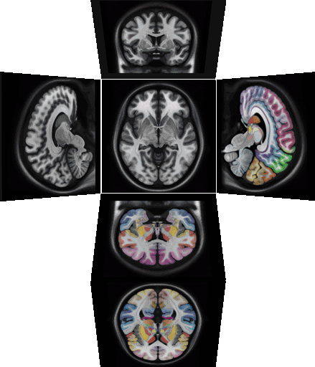
Method
Literature Search - Inclusion Criteria
Studies:
a) English peer-reviewed journal articles, b) Task-based fMRI studies with MNI/TAL coordinates,
c) Whole-brain acquired and analyzed results.
Samples:
a) Adults (mean age > 18 years old), b) Patients listed in DSM5 categories,
c) Control group without any psychiatric disorder, d) A minimum of 7 in patient/control group.
Contrast:
a) Emotion-eliciting paradigms (emotional stimuli, tasks, or both), b) Supraliminal emotional processing,
c) Between-group or group × condition effects in emotion-related activity (emotional vs. neutral contrasts).
source: https://mniatlas.thehumanbrain.info/
Notes:
For the literature search, qualified studies should meet the following criteria.
We focused on task-based fMRI studies reporting standardized brain coordinates from whole-brain analyses.
Participants should be adults, no matter in which groups; control participants should be completely healthy.
We included supraliminal emotional contrasts reporting significant between-group effects or group-by-condition interaction effects.

Slide 7
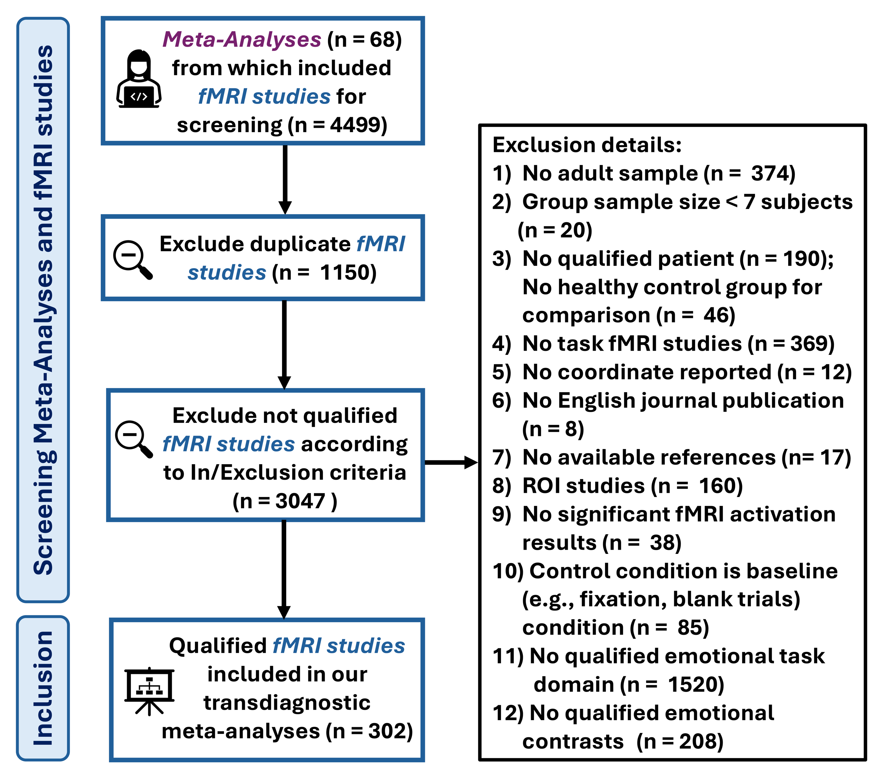
Method
Literature Search - PRISMA flowchart
Notes:
We started by identifying relevant meta-analyses and then screened the potentially eligible fMRI studies included in those meta-analyses.
After screening, we included 302 studies, involving around 6,000 patients and covering 14 DSM-5 diagnostic categories.

Slide 8
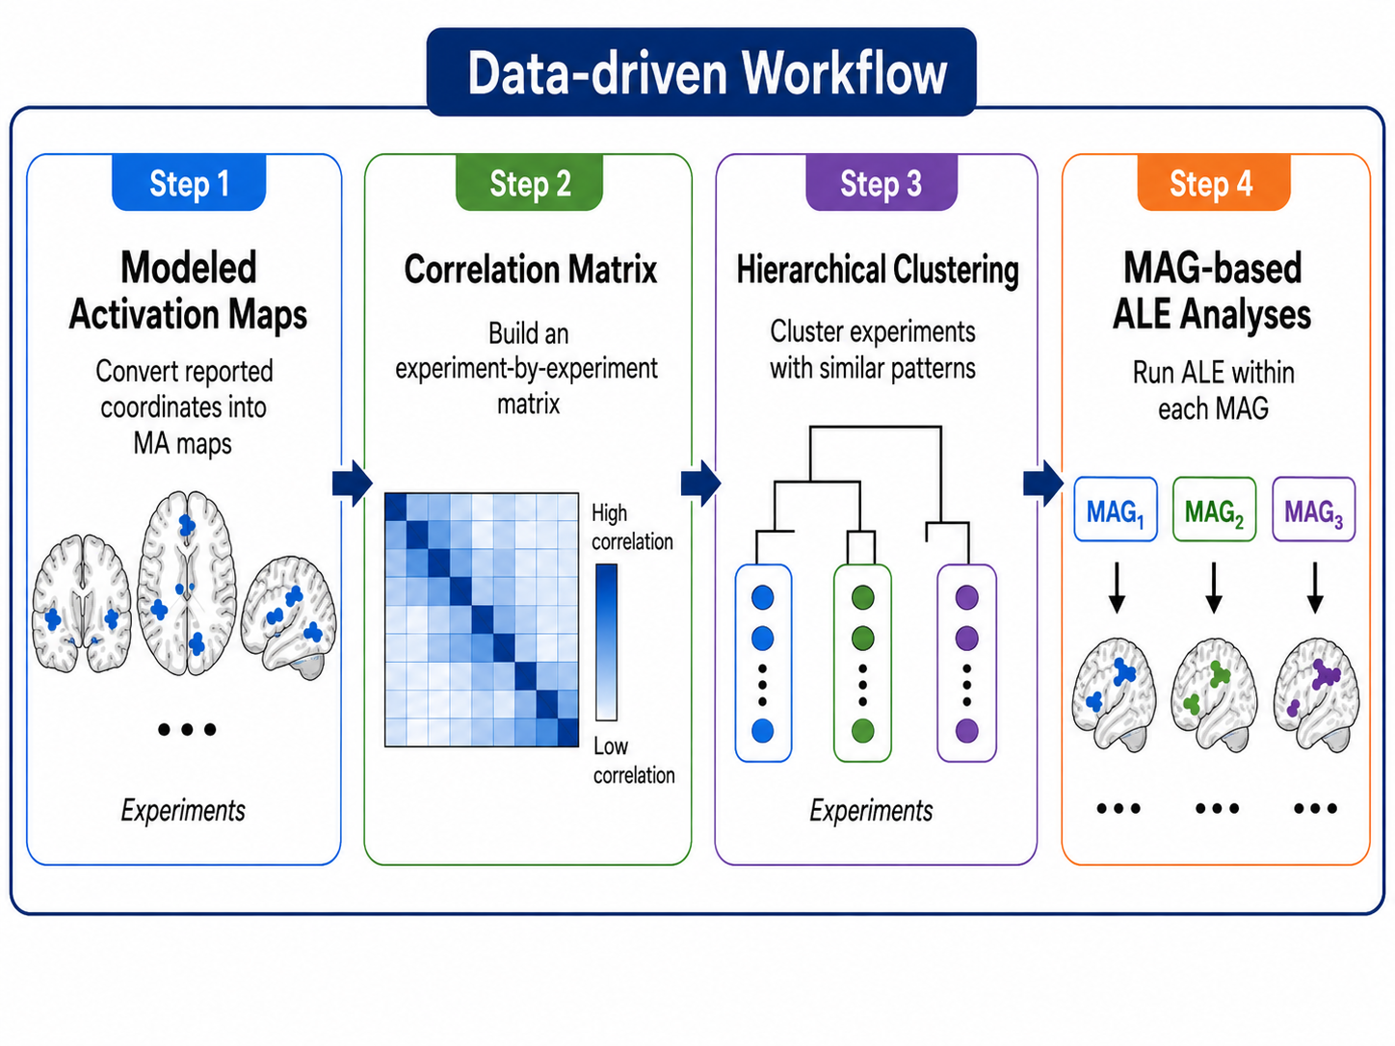
method
Overview of Analyses
Clustering is for creating new groupings
ALE in new groups
Notes:
Before moving to the results, I’ll briefly introduce the data-driven workflow.
We start with the same coordinate data.
But instead of assigning studies to predefined diagnostic categories, we cluster them according to the similarity of their spatial activation patterns. (the first three steps)
We then perform ALE within these newly defined groups.
So the key idea is quite simple:
We let the brain data define the groups, rather than fitting the data into an existing framework.

Slide 9
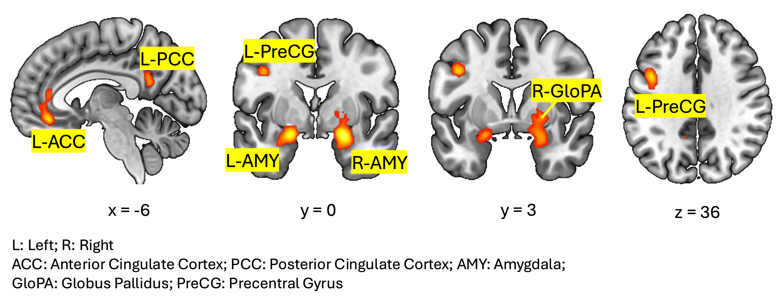
Results 1 What is shared across diagnoses
293 experiments included
cFWE p < 0.05 (0.001 clustering-forming threshold)
Notes:
Let’s first look at the overall cross-diagnostic analysis.
We identified five main regions of convergence.
These included key regions in the limbic system, particularly the bilateral amygdala;
regions associated with the default mode network, including the subgenual ACC and PCC extending partly into the precuneus;
and a frontoparietal region in the precentral gyrus, corresponding approximately to the inferior frontal junction.

Slide 10
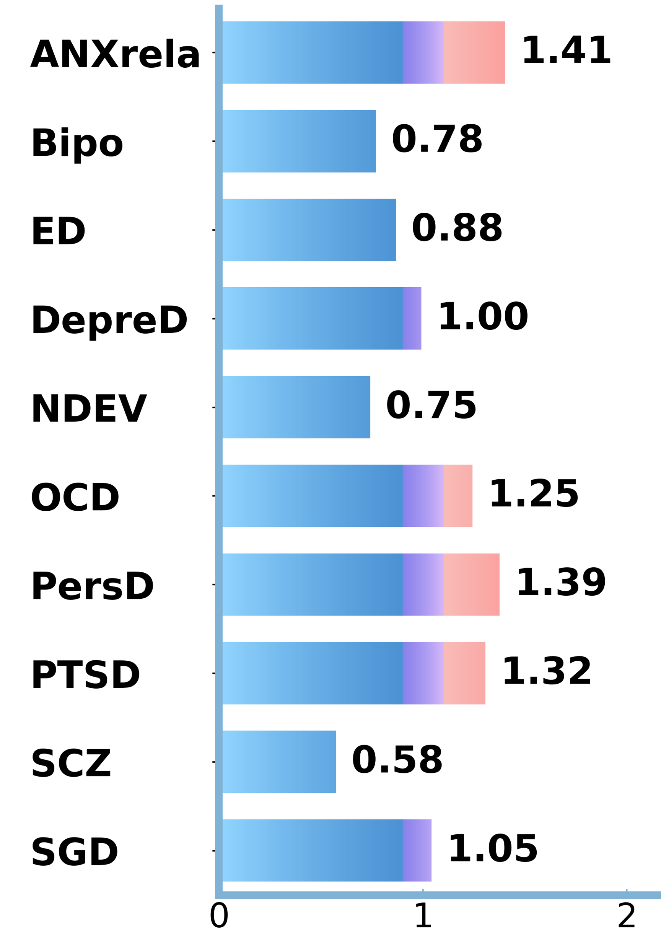
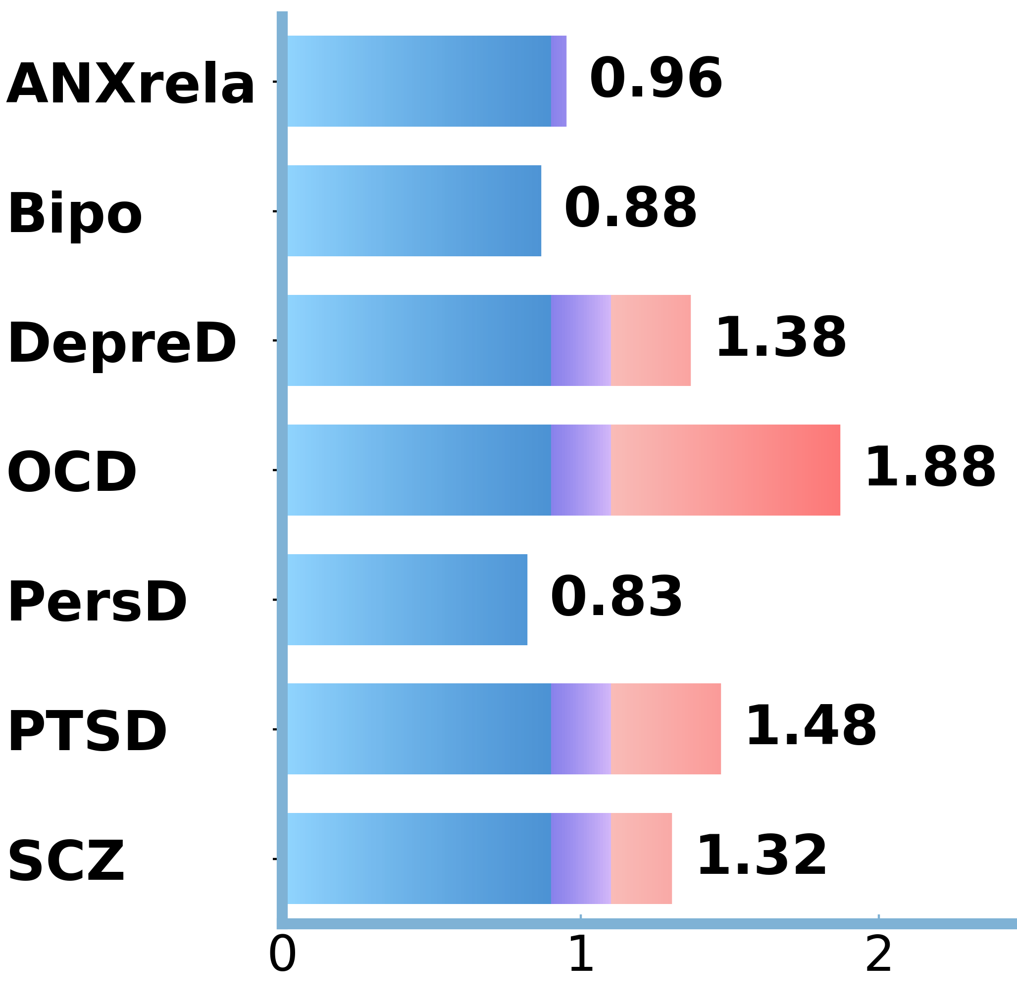
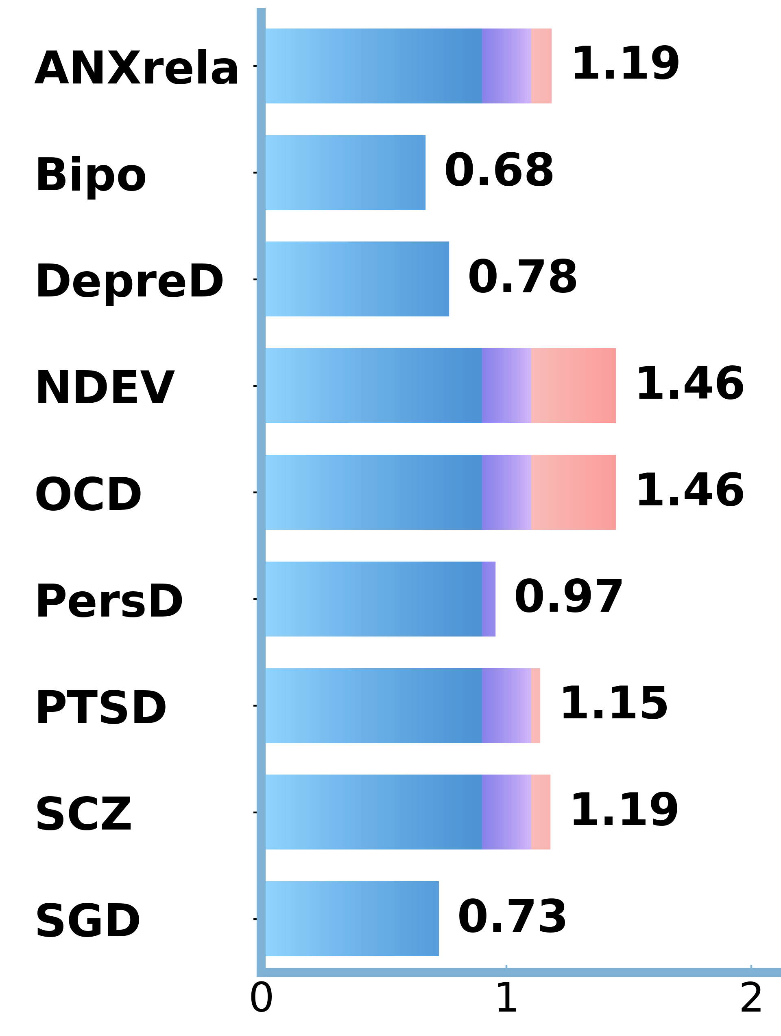
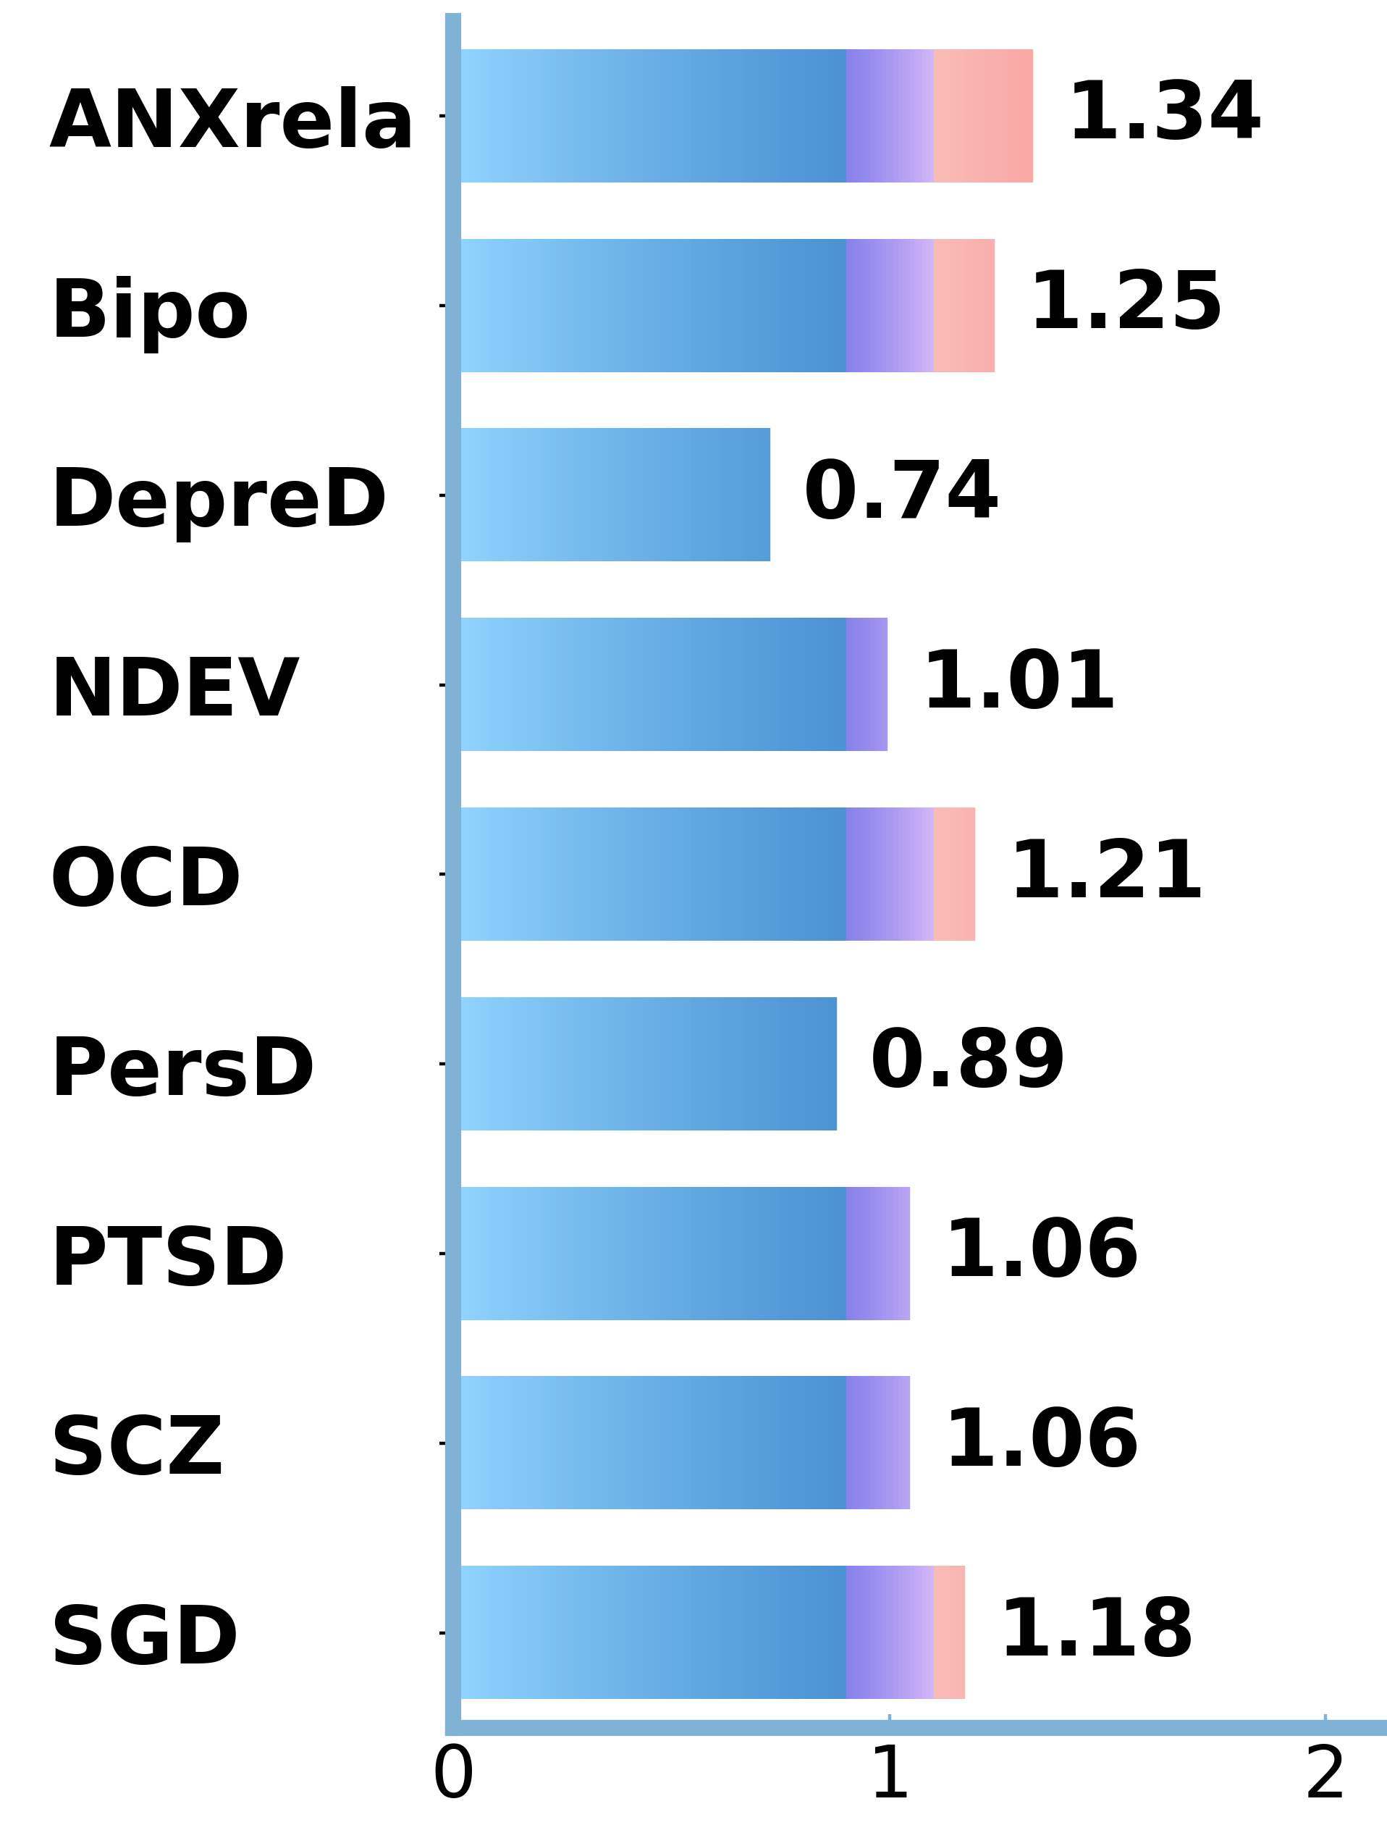
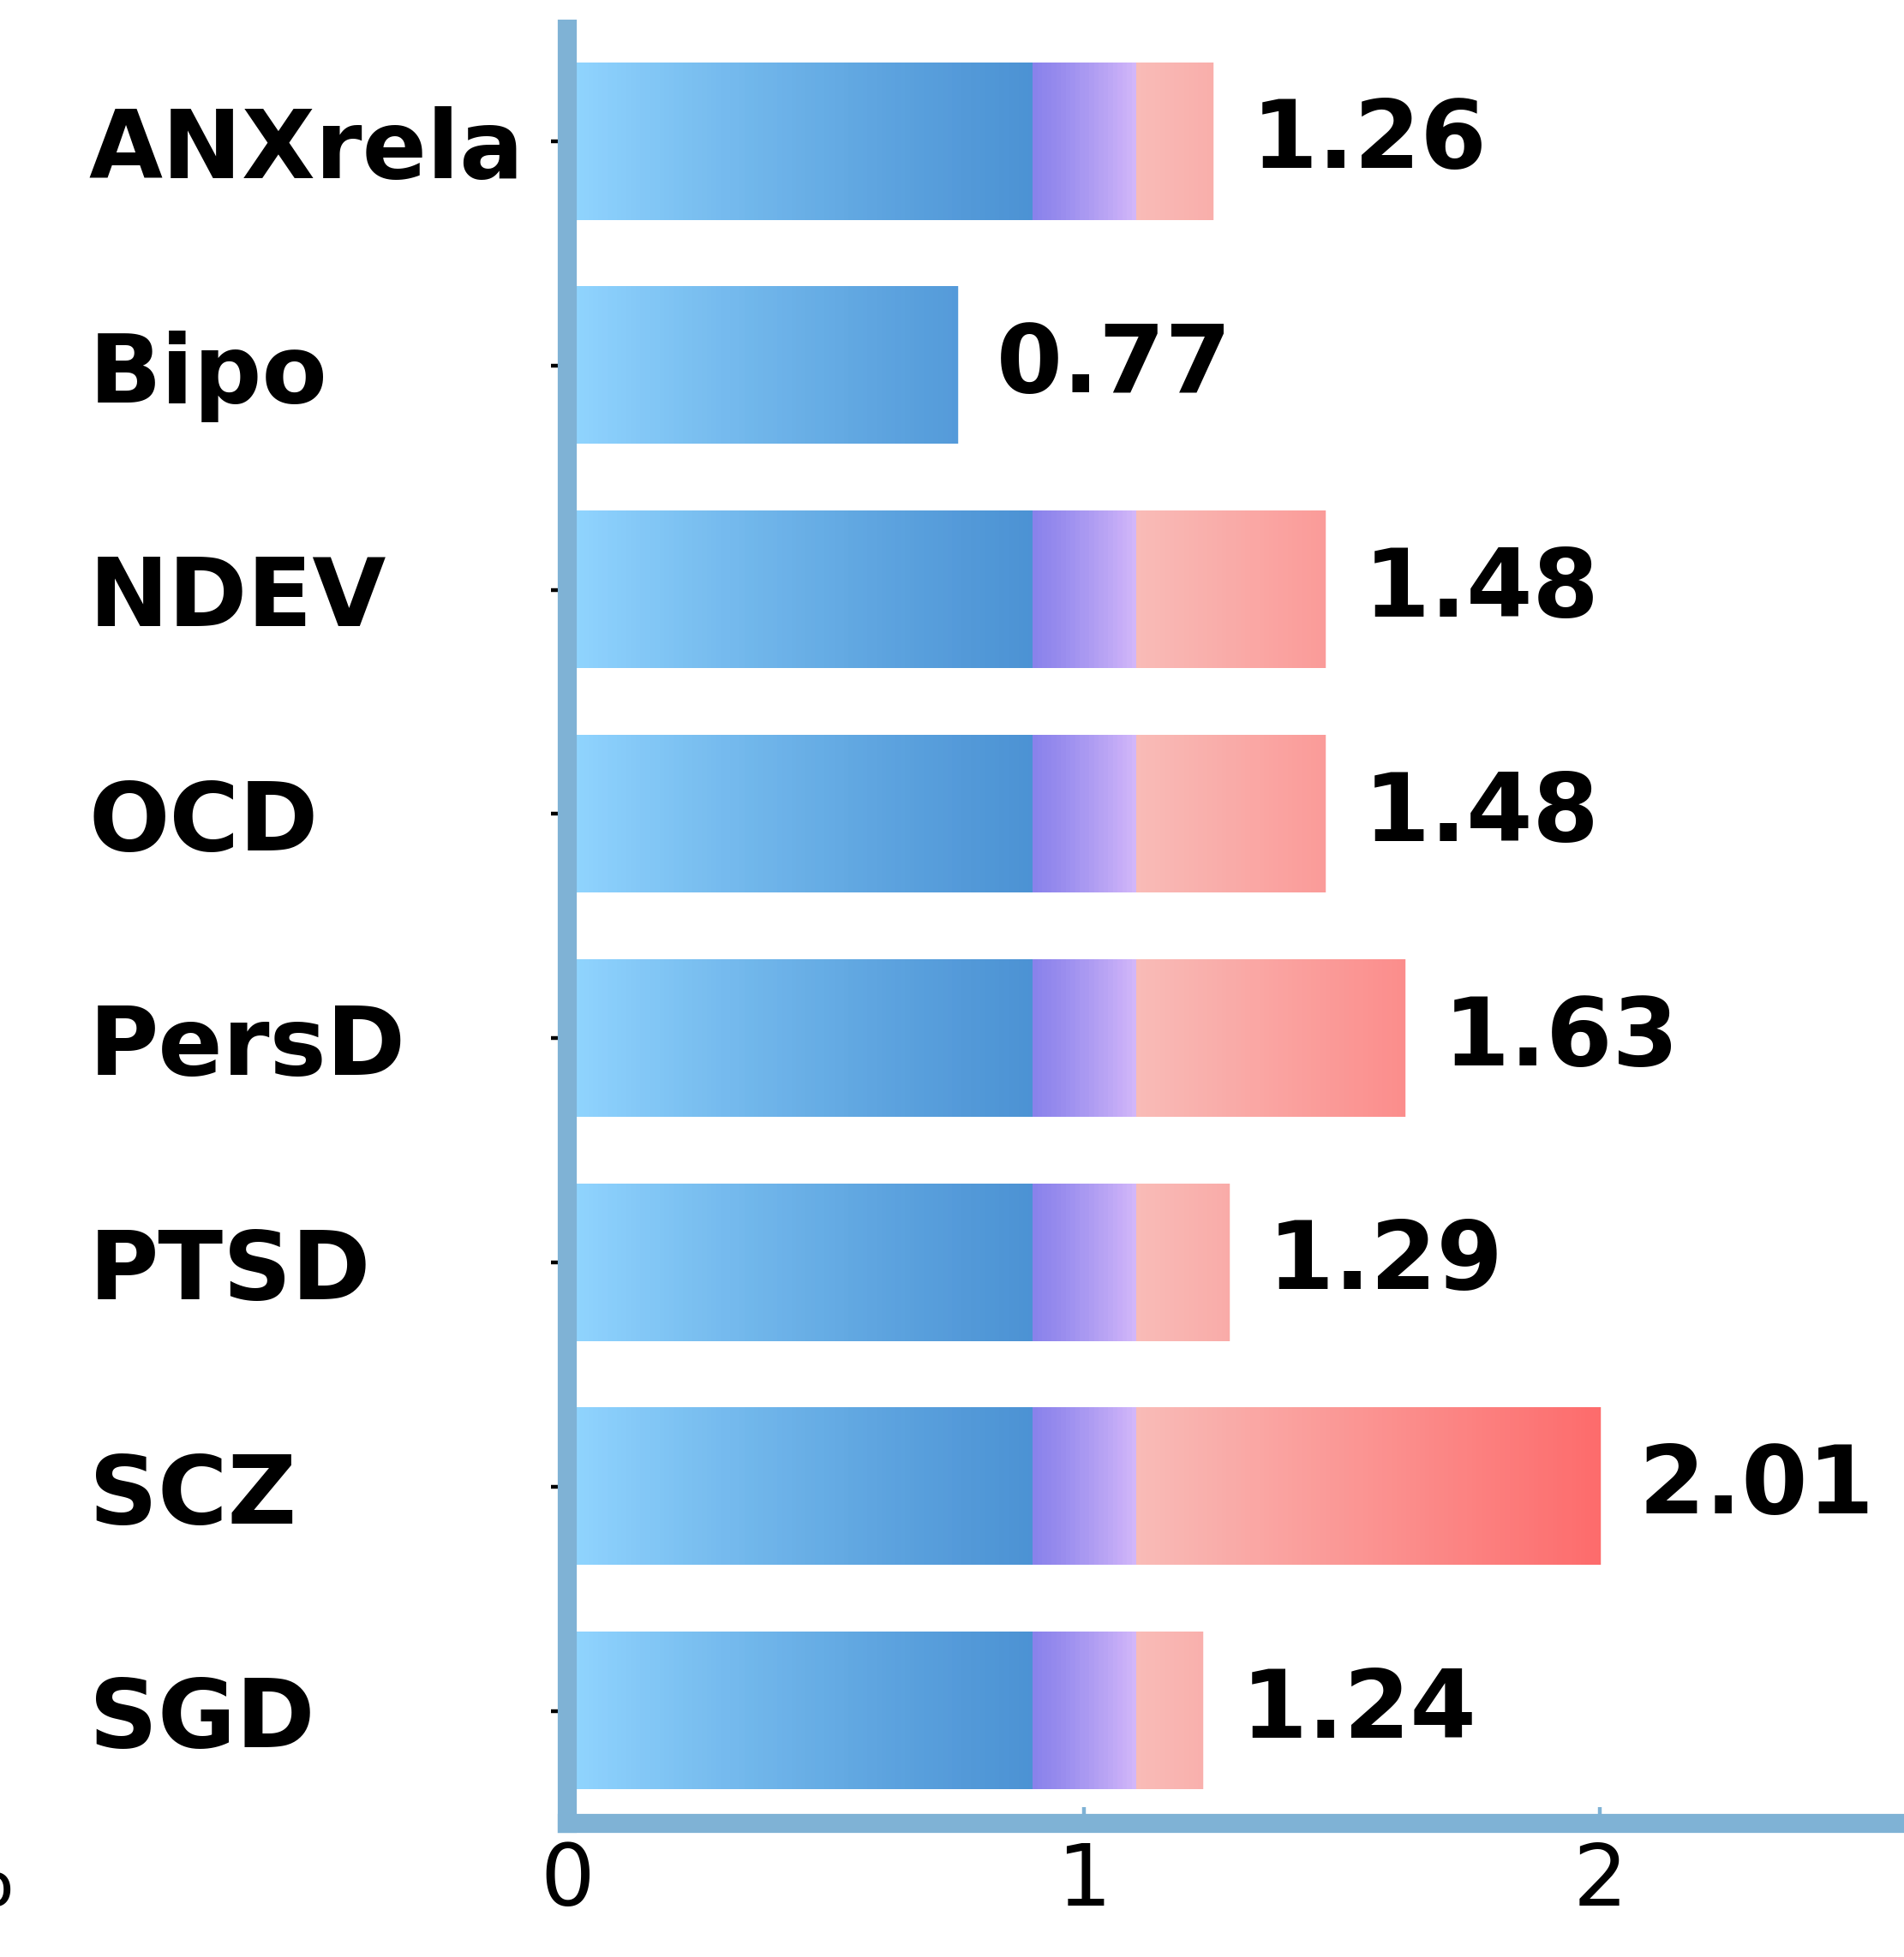
Results 1 What is shared across diagnoses
L-PreCG (38 exp)
ACC (56 exp)
Representation Ratio
L-PCC (29 exp)
L-Amygdala (48 exp)
R-Amygdala (71 exp)
Notes:
These bar plots are quite overwhelming, right?
let me walk you through it step by step.

Slide 11
Results 1 What is shared across diagnoses
Representation Ratio
ACC (56 exp)
Notes:
The blue bars show the representation ratio, which tells us whether a diagnosis contributes more or less than expected to the certain region.
For example, in the ACC, anxiety-related disorders contributed more than expected (the value >1), whereas schizophrenia contributed less than expected.

Slide 12
Results 1 What is shared across diagnoses
L-PreCG (38 exp)
ACC (56 exp)
Representation Ratio
L-PCC (29 exp)
L-Amygdala (48 exp)
R-Amygdala (71 exp)
Notes:
Overall, from the figures we can know, each region received contributions from multiple diagnoses, supporting a transdiagnostic pattern.
Across several regions, anxiety-related disorders, OCD, and PTSD tended to show relatively strong contributions.
Interestingly, these disorders also share clinical features such as hypervigilance and hyperarousal.
These features are less prominent in eating and bipolar disorders, which were also less strongly represented in these regions.

Slide 13
Results 2 What remains diagnosis-specific
✪
✪
✪
✪
Notes:
Next, we looked at the individual diagnostic categories.
Among the 14 categories, only four showed significant convergence: ANXrela, schizophrenia, bipolar, and personality disorders.
The other ten categories either showed no significant convergence or fell below the required threshold of 17 experiments for a robust ALE meta-analysis

Slide 14
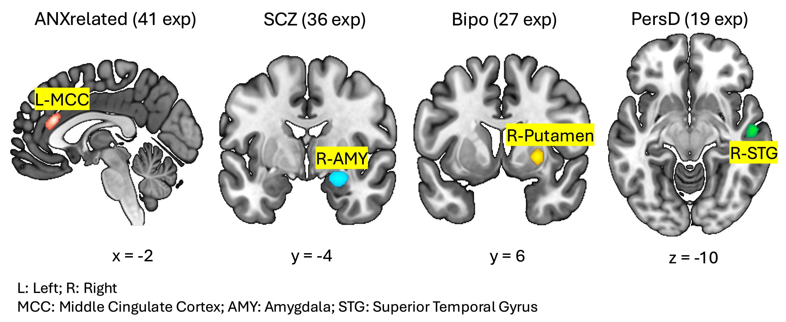
Results 2 What remains diagnosis-specific
cFWE p < 0.05 (0.001 cluster-forming threshold)
Notes:
For schizophrenia and bipolar disorder, their convergent regions overlapped with the transdiagnostic findings, while the MCC and STG appeared to show more disorder-specific convergence.
The MCC has been linked to cognitive control during negative affect and uncertainty, and it may help translate emotional information into adaptive behavior.
The STG is involved in processing social cues, which may be particularly relevant to the interpersonal difficulties often seen in personality disorders.

Slide 15
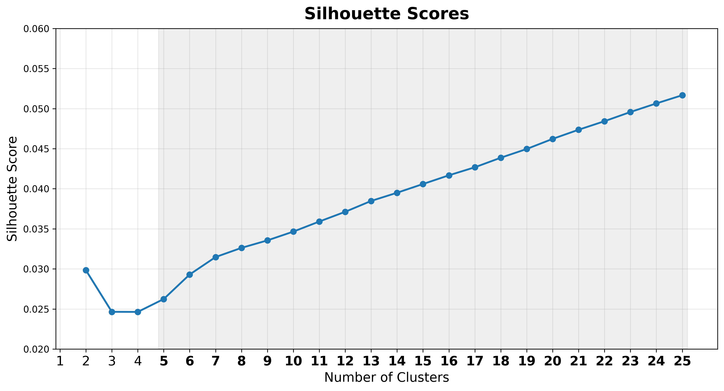
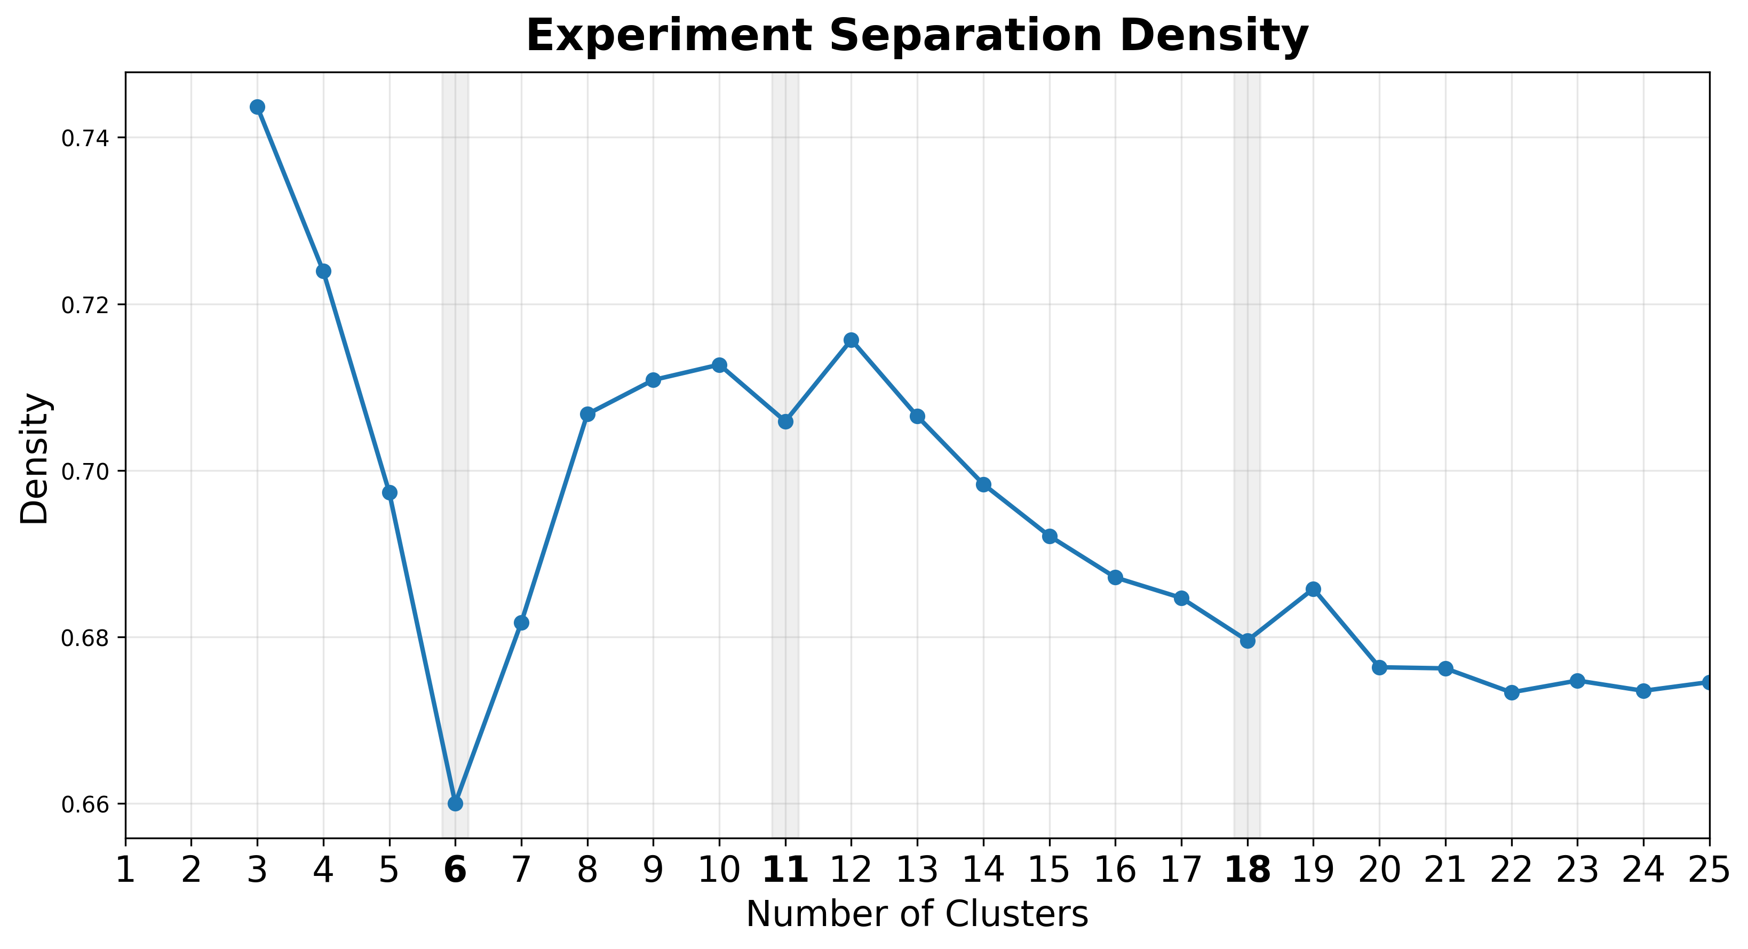
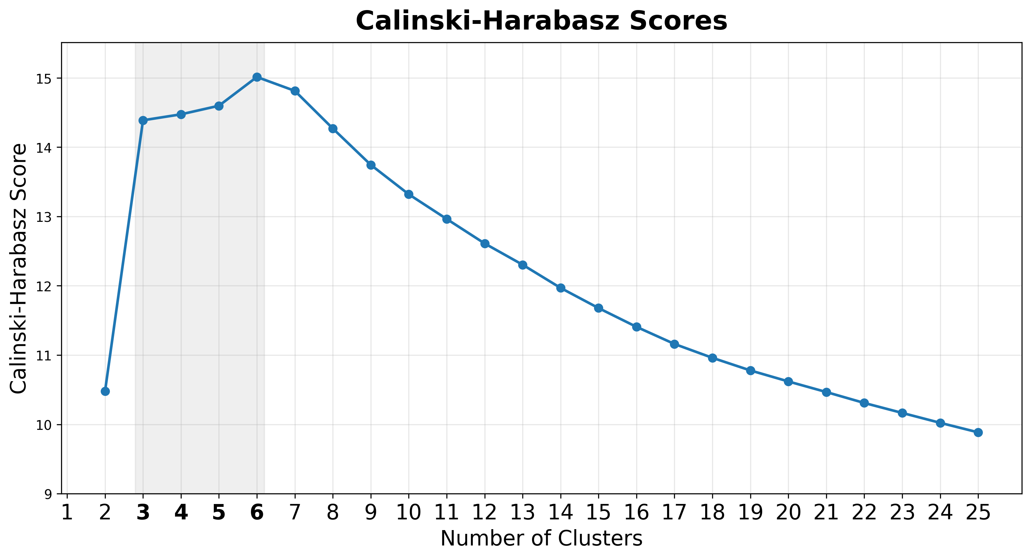
Results
Descriptive Statistics of MAGs - 507 experiments included
Notes:
We then moved to the data-driven analysis
After clustering and evaluating the metrics, the six-cluster provided the optimal solution.
Here you can see the number of experiments within each meta-analytical group, or MAG.
MAG-1 did not reach the minimum threshold of 17 experiments, so we did not perform ALE for that cluster.
For the remaining MAGs, I’ll briefly show two things:
what diagnostic categories clustered (i.e., diagnosis composition) in each MAG, and where the ALE convergence occurred.

Slide 16
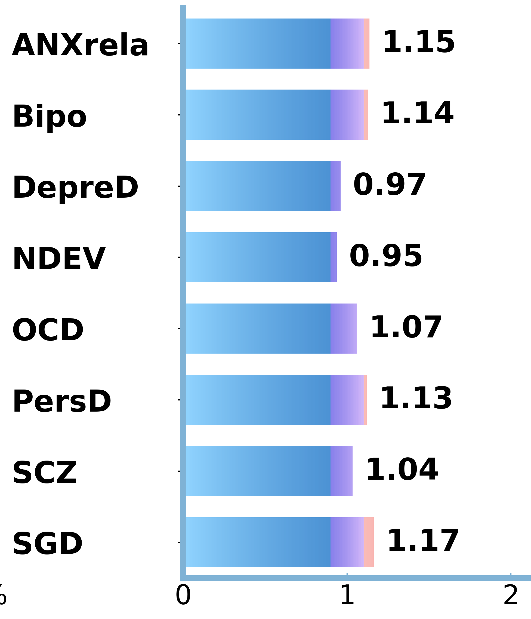
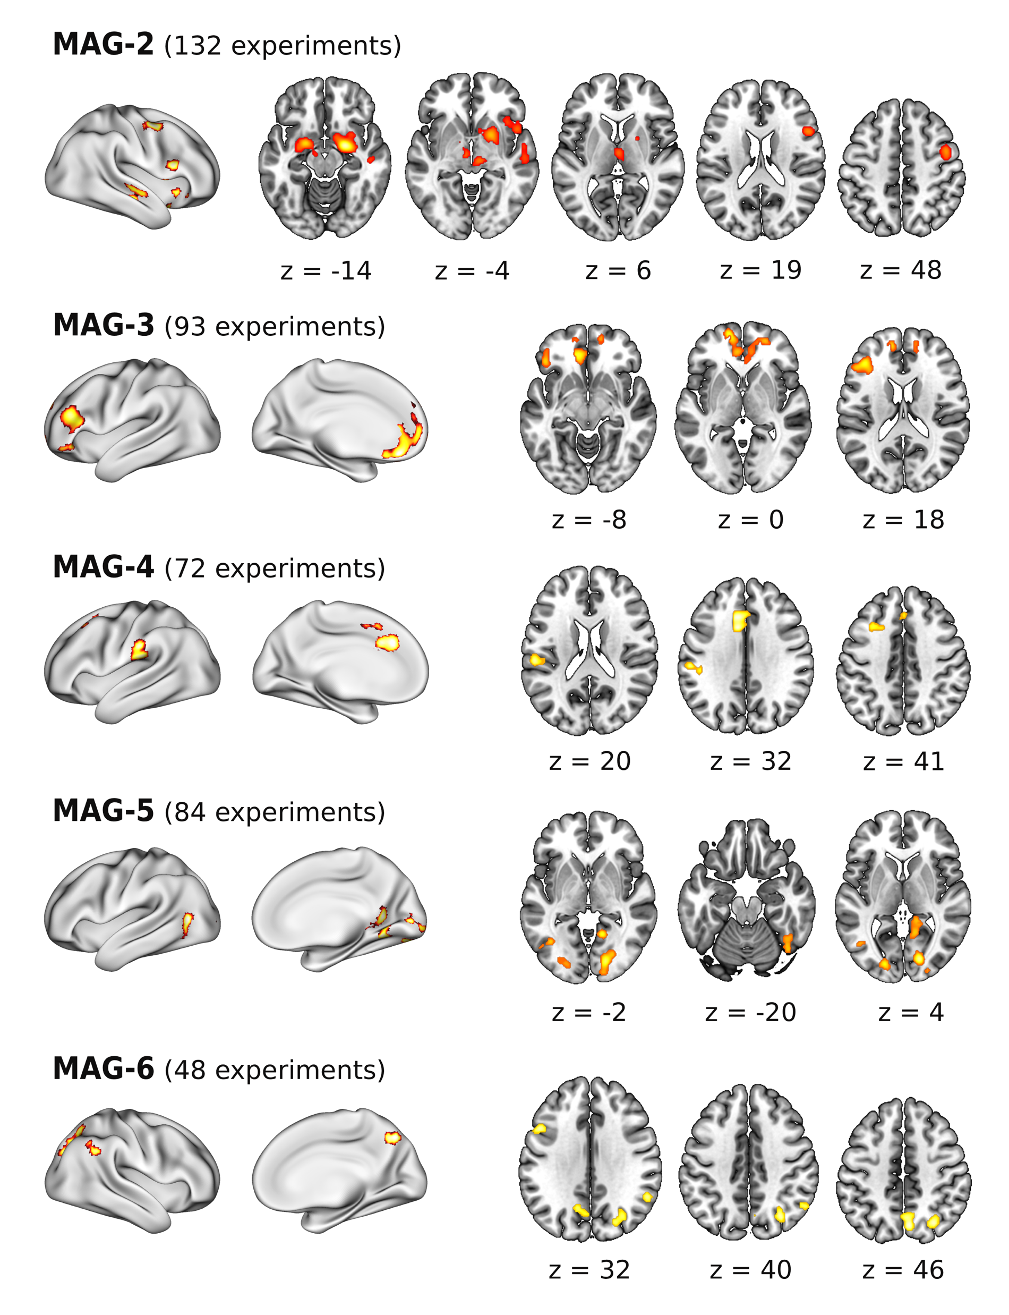
Results
MAG: Meta-Analytical Group
What additional cross-diagnostic pattern emerge
Largest MAG
“Initial Evaluation Structures”
Emotion generation, Automatic emotion evaluation/appraisal
MAG-2 (162 exp)
Notes:
First, MAG-2.
The number of experiments here is slightly different from the original clustering, because we merged overlapping samples before running the ALE analysis.
MAG-2 contained multiple diagnostic categories, with little contribution from ED or PTSD.
Convergence mainly involved the Initial Evaluation Structures, including the amygdala, thalamus, insula, putamen, and some frontal regions
MAG-2 may reflect an early stage of emotional processing, where emotional relevance is first detected and then integrated with other processes.

Slide 17
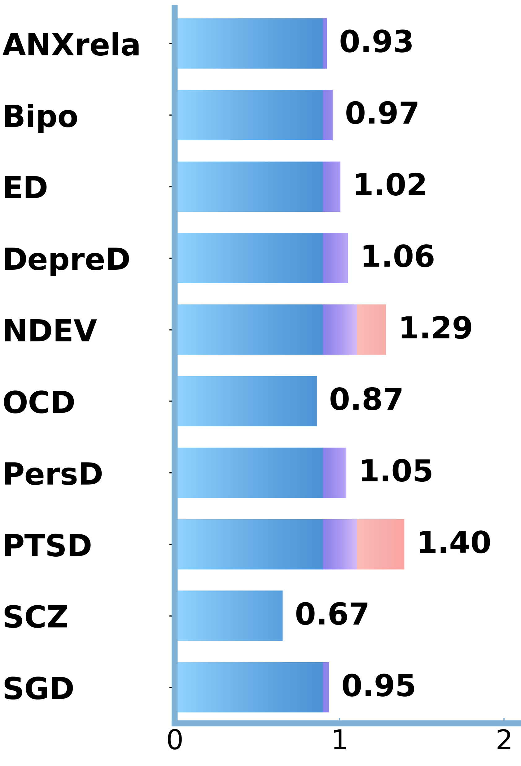
Results
What additional cross-diagnostic pattern emerge
Anhedonia-related symptoms
(subgenual) ACC, MFG, IFG, vmPFC
Emotional experience and valuation
MAG-3 (107 exp)
Notes:
MAG-3 showed relatively strong contributions from PTSD and NDEV.
Across disorders represented in this MAG, we see clinical features such as anhedonia, heightened arousal, negative affect, and atypical reward processing.
These symptoms may look quite different at the clinical level.
But they may share a more basic disturbance in how emotional value is experienced and processed.

Slide 18
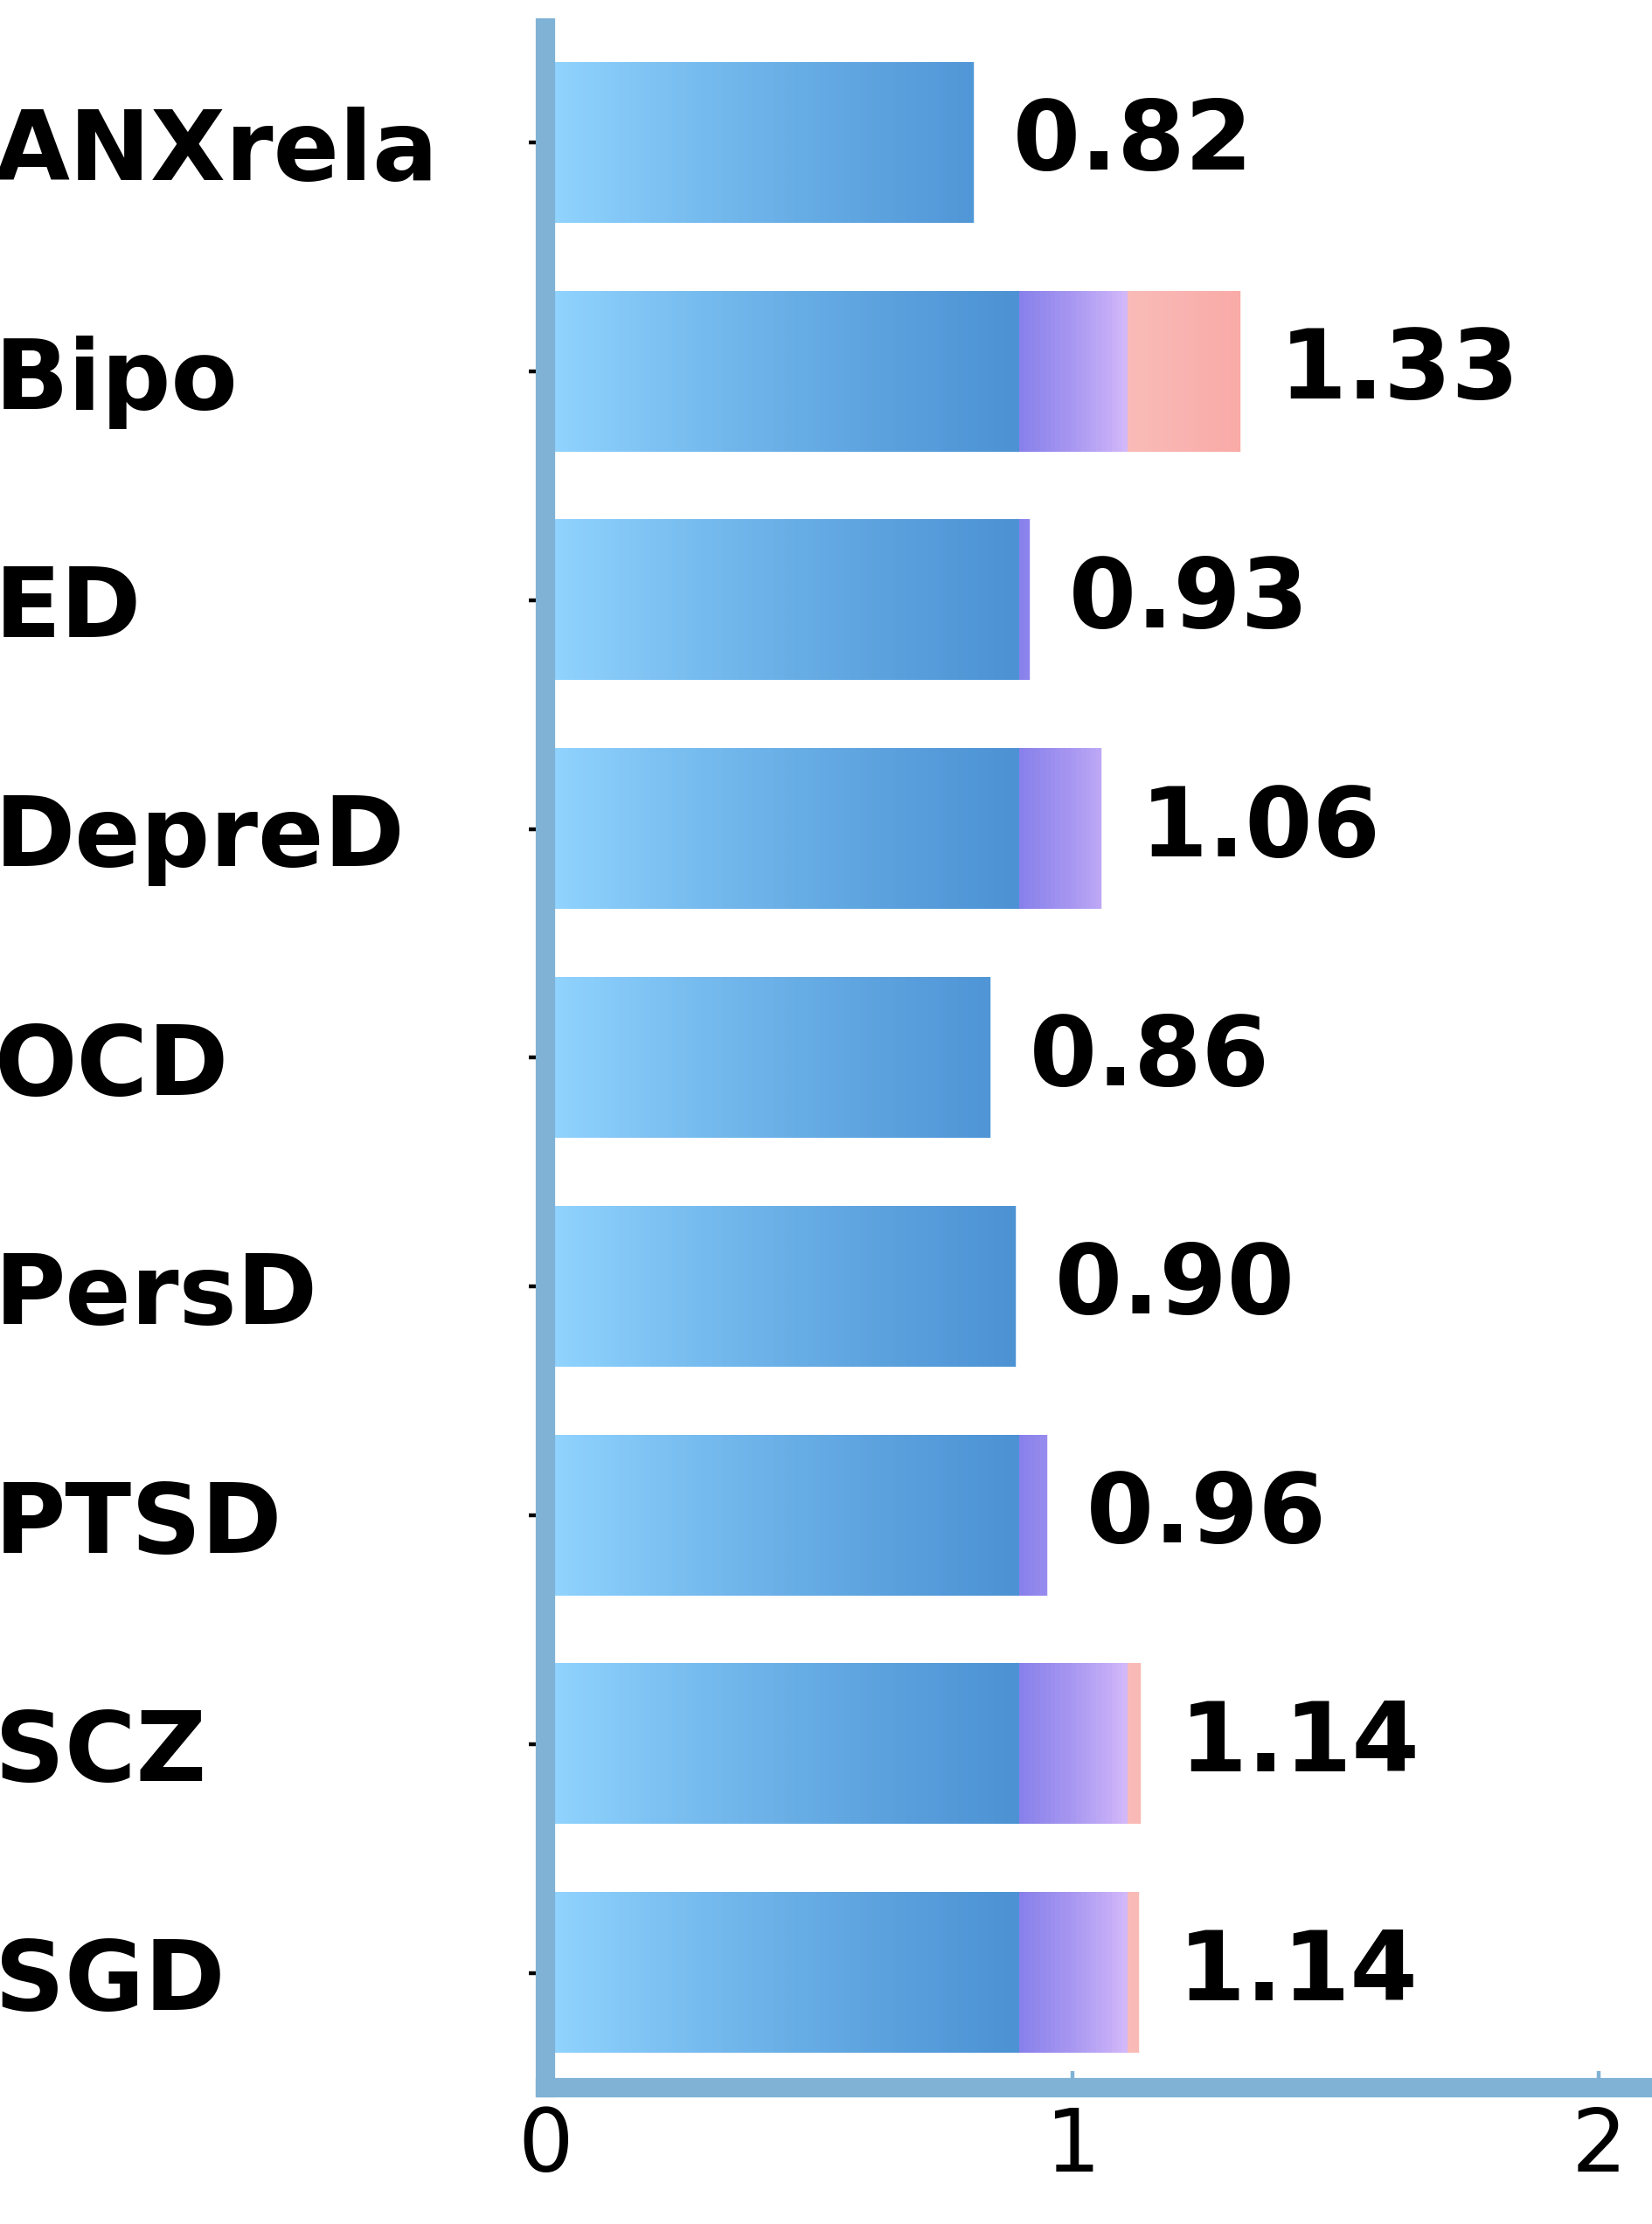
Results
What additional cross-diagnostic pattern emerge
MCC, Medial SFG (preSMA)
Integration and regulation of bodily (interoceptive) signals
MAG-4 (78 exp)
Notes:
MAG-4 showed a somewhat different pattern.
Compared with MAG-2 and MAG-3, it had a particularly strong composition from bipolar disorder.
The convergent regions are associated with emotional and cognitive control, sensory integration, and interoceptive processing.
Interestingly, emotion-regulation paradigms were also strongly overrepresented in this cluster,
for time reasons, I don’t show the task composition here.

Slide 19
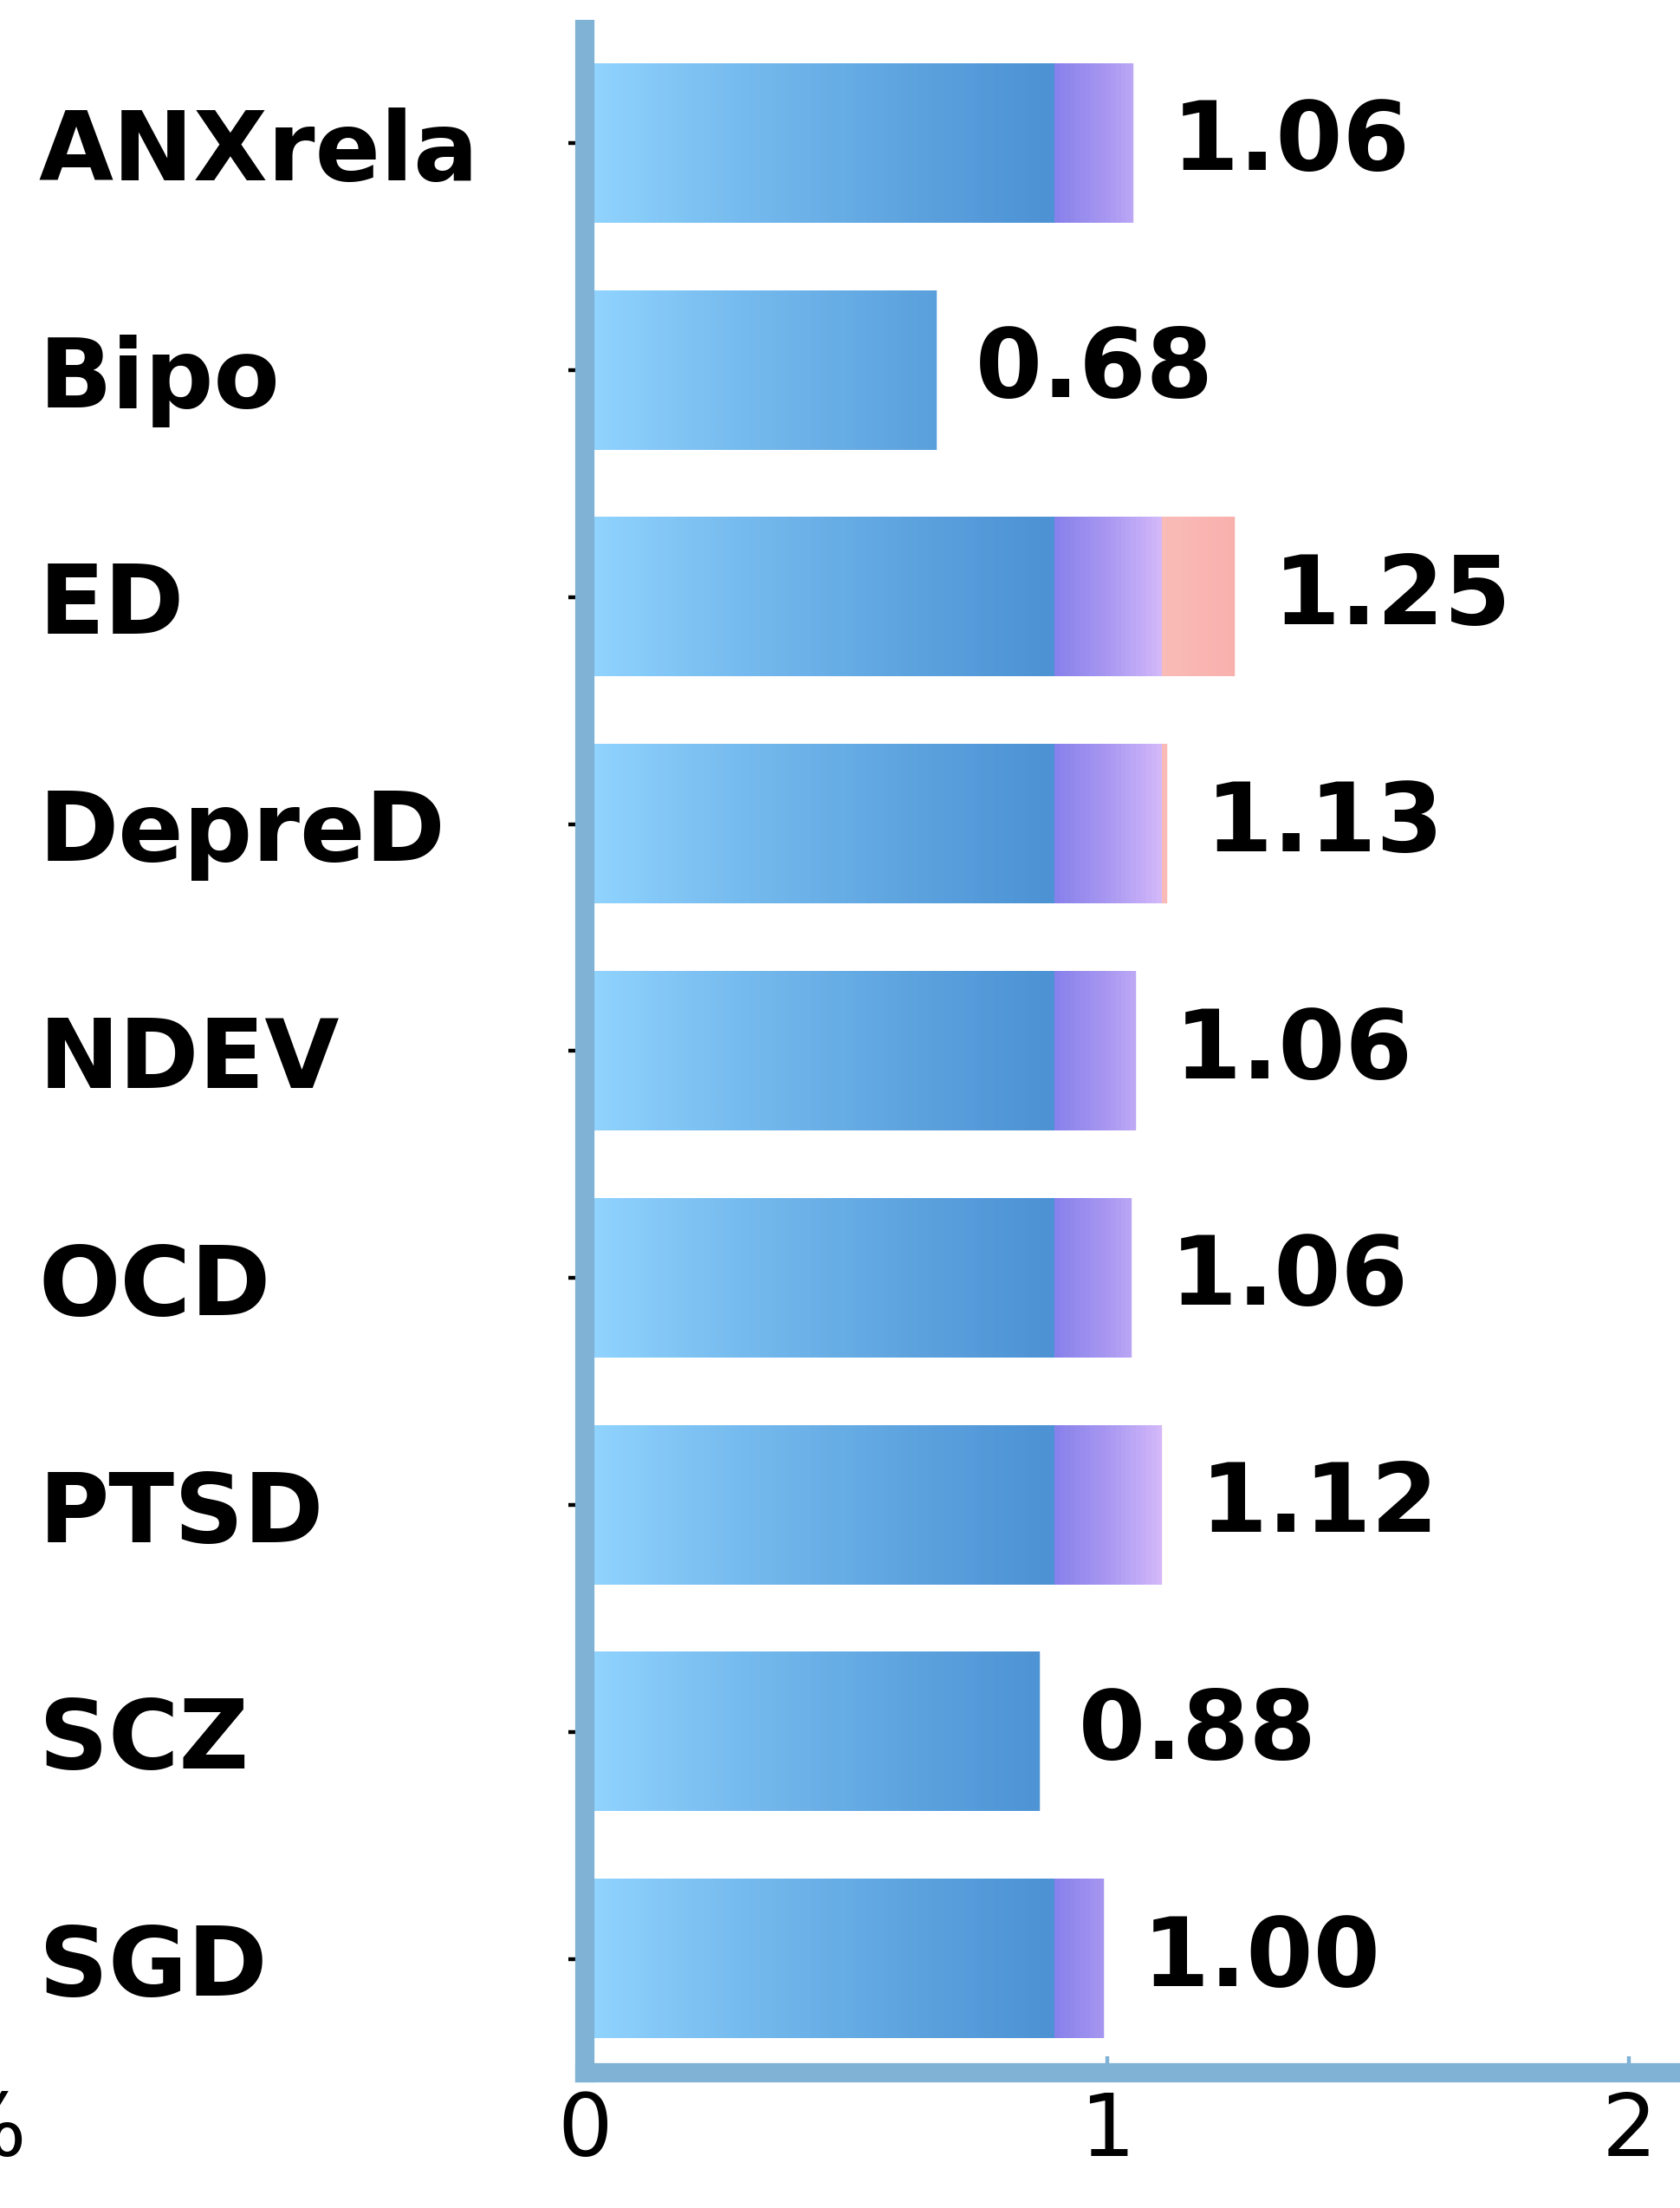
Results
What additional cross-diagnostic pattern emerge
Lingual Gyrus, Fusiform Gyrus, PCC
Visual perception and attention deficits
MAG-5 (101 exp)
Notes:
MAG-5 included frequent composition from a bunch of diagnoses.
It also stood out for having relatively more anticipation and perception studies.
Functionally, the convergent pattern appears to involve directing and maintaining attention toward emotional cues.
In psychiatric populations, these processing may contribute to negatively biased mental imagery, which can make threats feel stronger and emotional experiences more vivid.

Slide 20
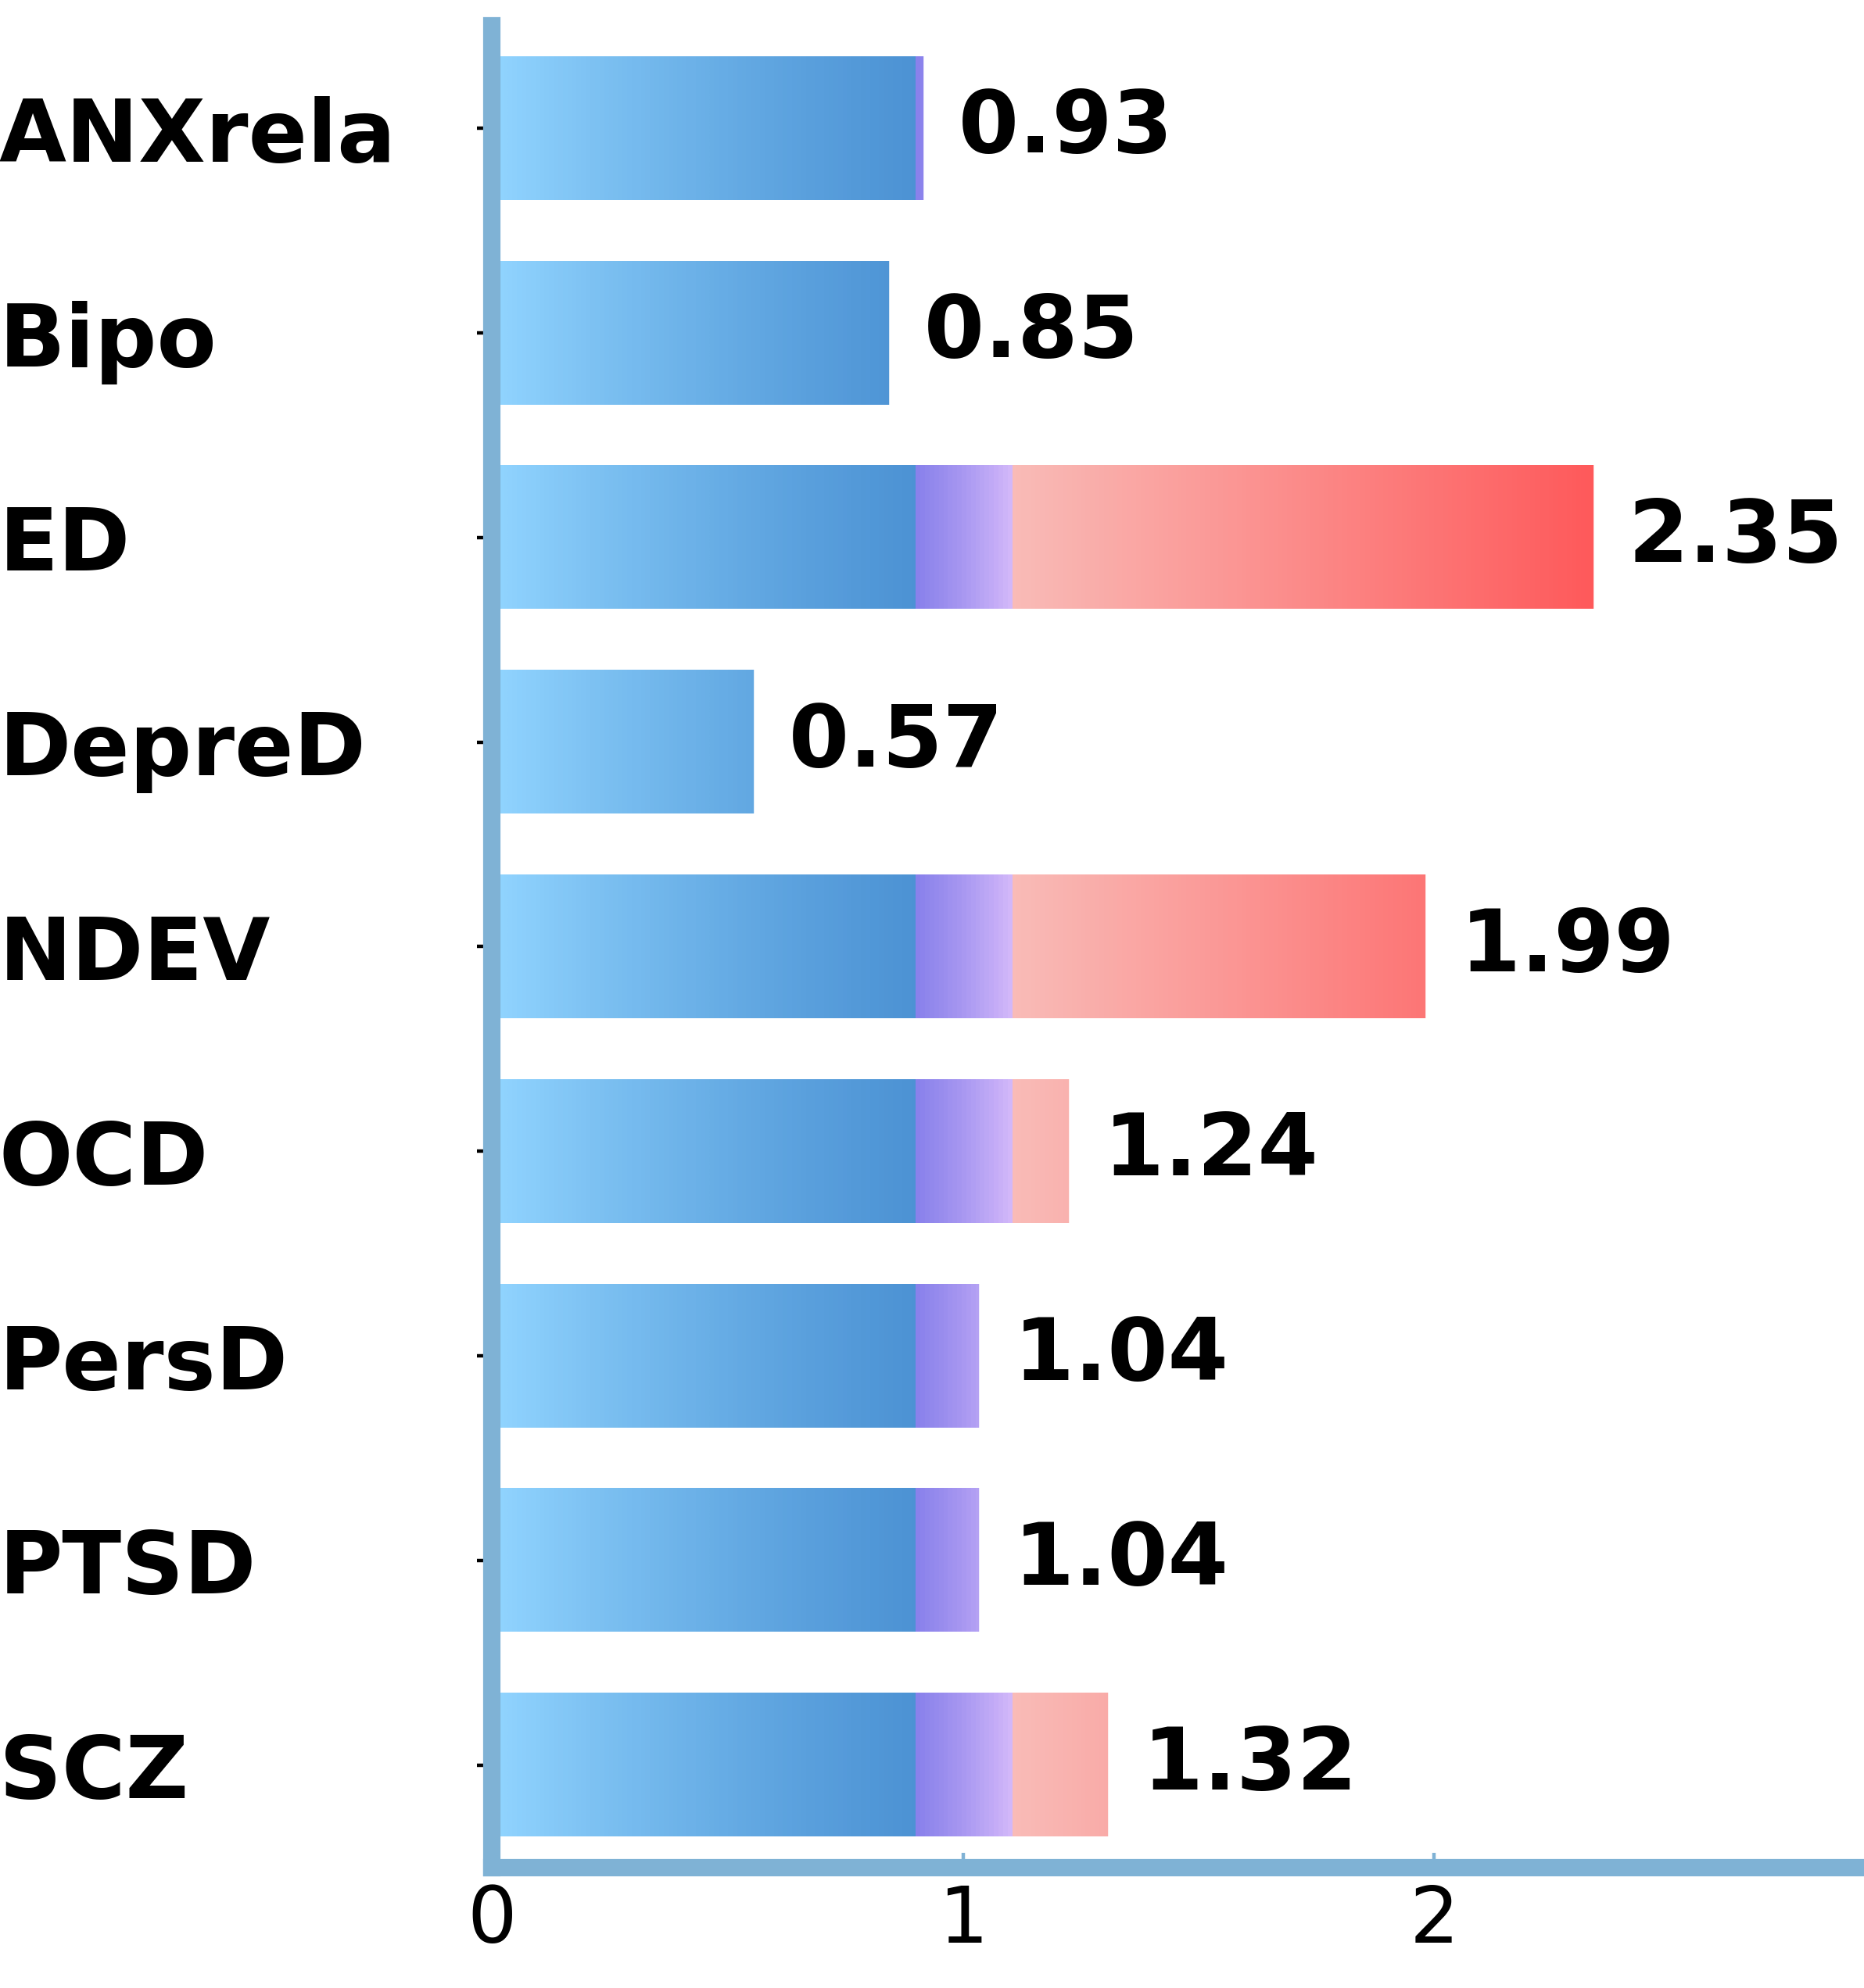
Results
What additional cross-diagnostic pattern emerge
Key DMN regions and the Inferior Parietal Sulcus
Disrupted internal representations/self‑reflection
MAG-6 (54 exp)
Notes:
Finally, MAG-6 was mainly driven by ED, NDEV, OCD, and schizophrenia, with ED showing the strongest composition.
We found convergence in key DMN regions and the Inferior Parietal Sulcus.
This may reflect disrupted coordination between self-related processing and executive control. Overall, the five MAGs capture different functional aspects of altered emotional processing.

Slide 21
Discussion
Findings
Overall cross-diagnostic alteration with consistency largely overlapped with eSAD network.
Conventional ALE mainly identifies where abnormalities converge.
Data-driven clustering provides a more network-oriented perspective.
Clustering + ALE revealed additional latent cross-diagnostic networks.
Data-driven transdiagnostic meta-analysis can help explain shared symptoms beyond predefined diagnostic boundaries
Notes:
So, to summarize the main findings:
the cross-diagnostic pattern largely overlapped with the extended social affective default mode (or we call it eSAD) network.
The category-driven approach shows where effects converge, while the data-driven approach reveals broader network patterns.
Together, they provide a more complete picture of shared emotional dysfunction across psychiatric disorders.
So the take-home message is:
Data-driven meta-analysis can complement conventional ALE by revealing patterns beyond diagnostic boundaries.

Slide 22
Discussion
Limitations
Uneven representation across diagnostic categories
Limited clinical information for moderator analyses
Future directions
Apply analyses to other symptom domains
Validate network robustness and clinical relevance with predictive models
Notes:
There are still limitations to this study.
First, the diagnostic categories were not equally represented in the dataset. Some findings may be driven more by disorders with more available studies.
Second, clinical factors like medication and comorbidities were not consistently reported, so we could not examine them systematically.
In future work, we plan to extend this framework to other symptom domains and test whether these networks may have predictive or clinical value using machine learning.

Slide 23












acknowledgement
Dr. rer. medic.
Veronika Müller
Univ.-Prof. Dr. med
Simon B. Eickhoff
Dr. rer. medic. Edna Cieslik
Lennart Frahm
Dr. Masoud Tahmasian
Univ.-Prof. Mag. Dr.
Carmen Morawetz
Dr.
Jules Dugre
Prof. Dr. med.
Leonhard Schilbach
Sincere thanks to the members of the Cognitive and Affective Biopsychology (CAB) Group and INM-7 for constructive feedback, and fruitful discussions.
Notes:
Finally I’d like to thank all my collaborators and colleagues for their valuable contributions and support.

Slide 24
References
Müller, V. I., Cieslik, E. C., Laird, A. R., Fox, P. T., Radua, J., Mataix-Cols, D., Tench, C. R., Yarkoni, T., Nichols, T. E., Turkeltaub, P. E., Wager, T. D., & Eickhoff, S. B. (2018). Ten simple rules for neuroimaging meta-analysis. Neurosci Biobehav Rev, 84, 151-161.
Eickhoff, S. B., Nichols, T. E., Laird, A. R., Hoffstaedter, F., Amunts, K., Fox, P. T., Bzdok, D., & Eickhoff, C. R. (2016). Behavior, sensitivity, and power of activation likelihood estimation characterized by massive empirical simulation. Neuroimage, 137, 70-85.
Tahmasian, M., Sepehry, A. A., Samea, F., Khodadadifar, T., Soltaninejad, Z., Javaheripour, N., Khazaie, H., Zarei, M., Eickhoff, S. B., & Eickhoff, C. R. (2019). Practical recommendations to conduct a neuroimaging meta-analysis for neuropsychiatric disorders. Human Brain Mapping, 40(17), 5142-5154.
McTeague, L. M., Rosenberg, B. M., Lopez, J. W., Carreon, D. M., Huemer, J., Jiang, Y., Chick, C. F., Eickhoff, S. B., & Etkin, A. (2020). Identification of Common Neural Circuit Disruptions in Emotional Processing Across Psychiatric Disorders. American Journal of Psychiatry, 177(5), 411-421.
Boisvert, M., Dugré, J. R., & Potvin, S. (2024). Patterns of abnormal activations in severe mental disorders a transdiagnostic data-driven meta-analysis of task-based fMRI studies. Psychological Medicine, 1-12.
Dugré, J. R., Eickhoff, S. B., & Potvin, S. (2022). Meta-analytical transdiagnostic neural correlates in common pediatric psychiatric disorders. Scientific Reports, 12(1).
Morawetz, C., Hemetsberger, F. J., Laird, A. R., & Kohn, N. (2025). Emotion regulation: From neural circuits to a transdiagnostic perspective. Neurosci Biobehav Rev, 168, 105960.
Langner, R., Leiberg, S., Hoffstaedter, F., & Eickhoff, S. B. (2018). Towards a human self-regulation system: Common and distinct neural signatures of emotional and behavioural control. Neurosci Biobehav Rev, 90, 400-410.
Amft, M., Bzdok, D., Laird, A. R., Fox, P. T., Schilbach, L., & Eickhoff, S. B. (2015). Definition and characterization of an extended social-affective default network. Brain Struct Funct, 220(2), 1031-1049.
Forbes, M. K., Baillie, A., Batterham, P. J., Calear, A., Kotov, R., Krueger, R. F., Markon, K. E., Mewton, L., Pellicano, E., Roberts, M., Rodriguez-Seijas, C., Sunderland, M., Watson, D., Watts, A. L., Wright, A. G. C., & Clark, L. A. (2025). Reconstructing Psychopathology: A Data-Driven Reorganization of the Symptoms in the Diagnostic and Statistical Manual of Mental Disorders. Clinical Psychological Science, 13(3), 462-488.
Riedel, M. C., Yanes, J. A., Ray, K. L., Eickhoff, S. B., Fox, P. T., Sutherland, M. T., & Laird, A. R. (2018). Dissociable meta-analytic brain networks contribute to coordinated emotional processing. Human Brain Mapping, 39(6), 2514-2531.
Liu, X., Zhu, X. H., Qiu, P., & Chen, W. (2012). A correlation-matrix-based hierarchical clustering method for functional connectivity analysis. J Neurosci Methods, 211(1), 94-102.
Notes:
And this is the end of my talk, thank you for listening

